Slide 1

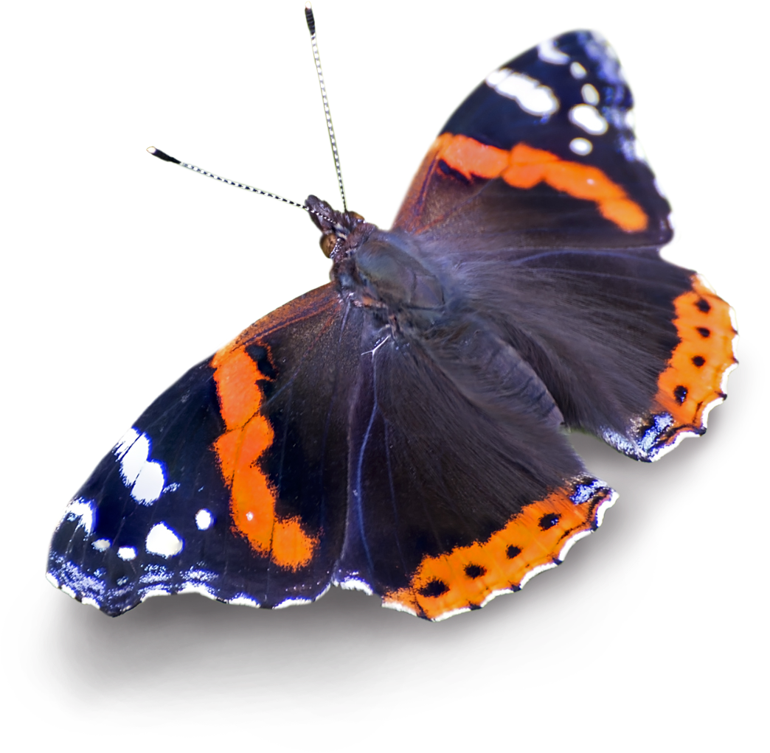
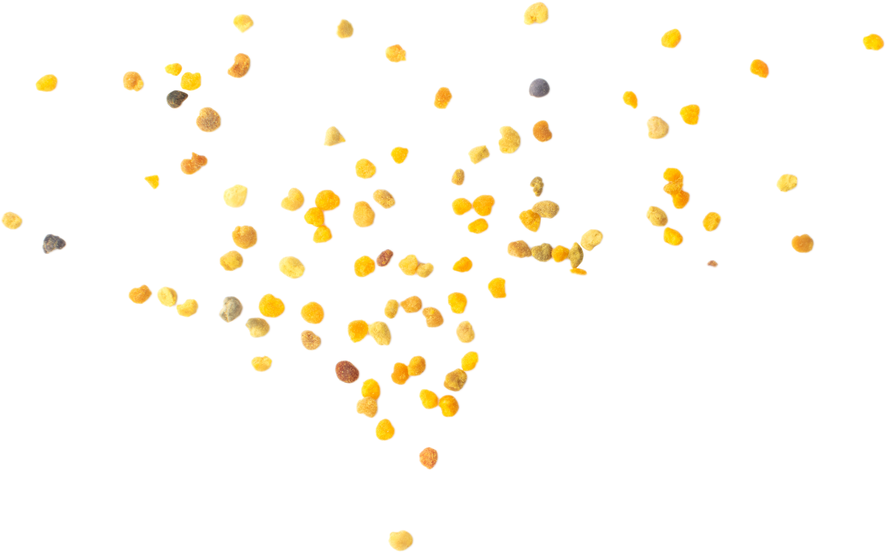
Interdependence and pollination
A session from the ecology service supporting the
Bee Superhighway
Page 1 of 10 | Interdependence and pollination

Slide 2
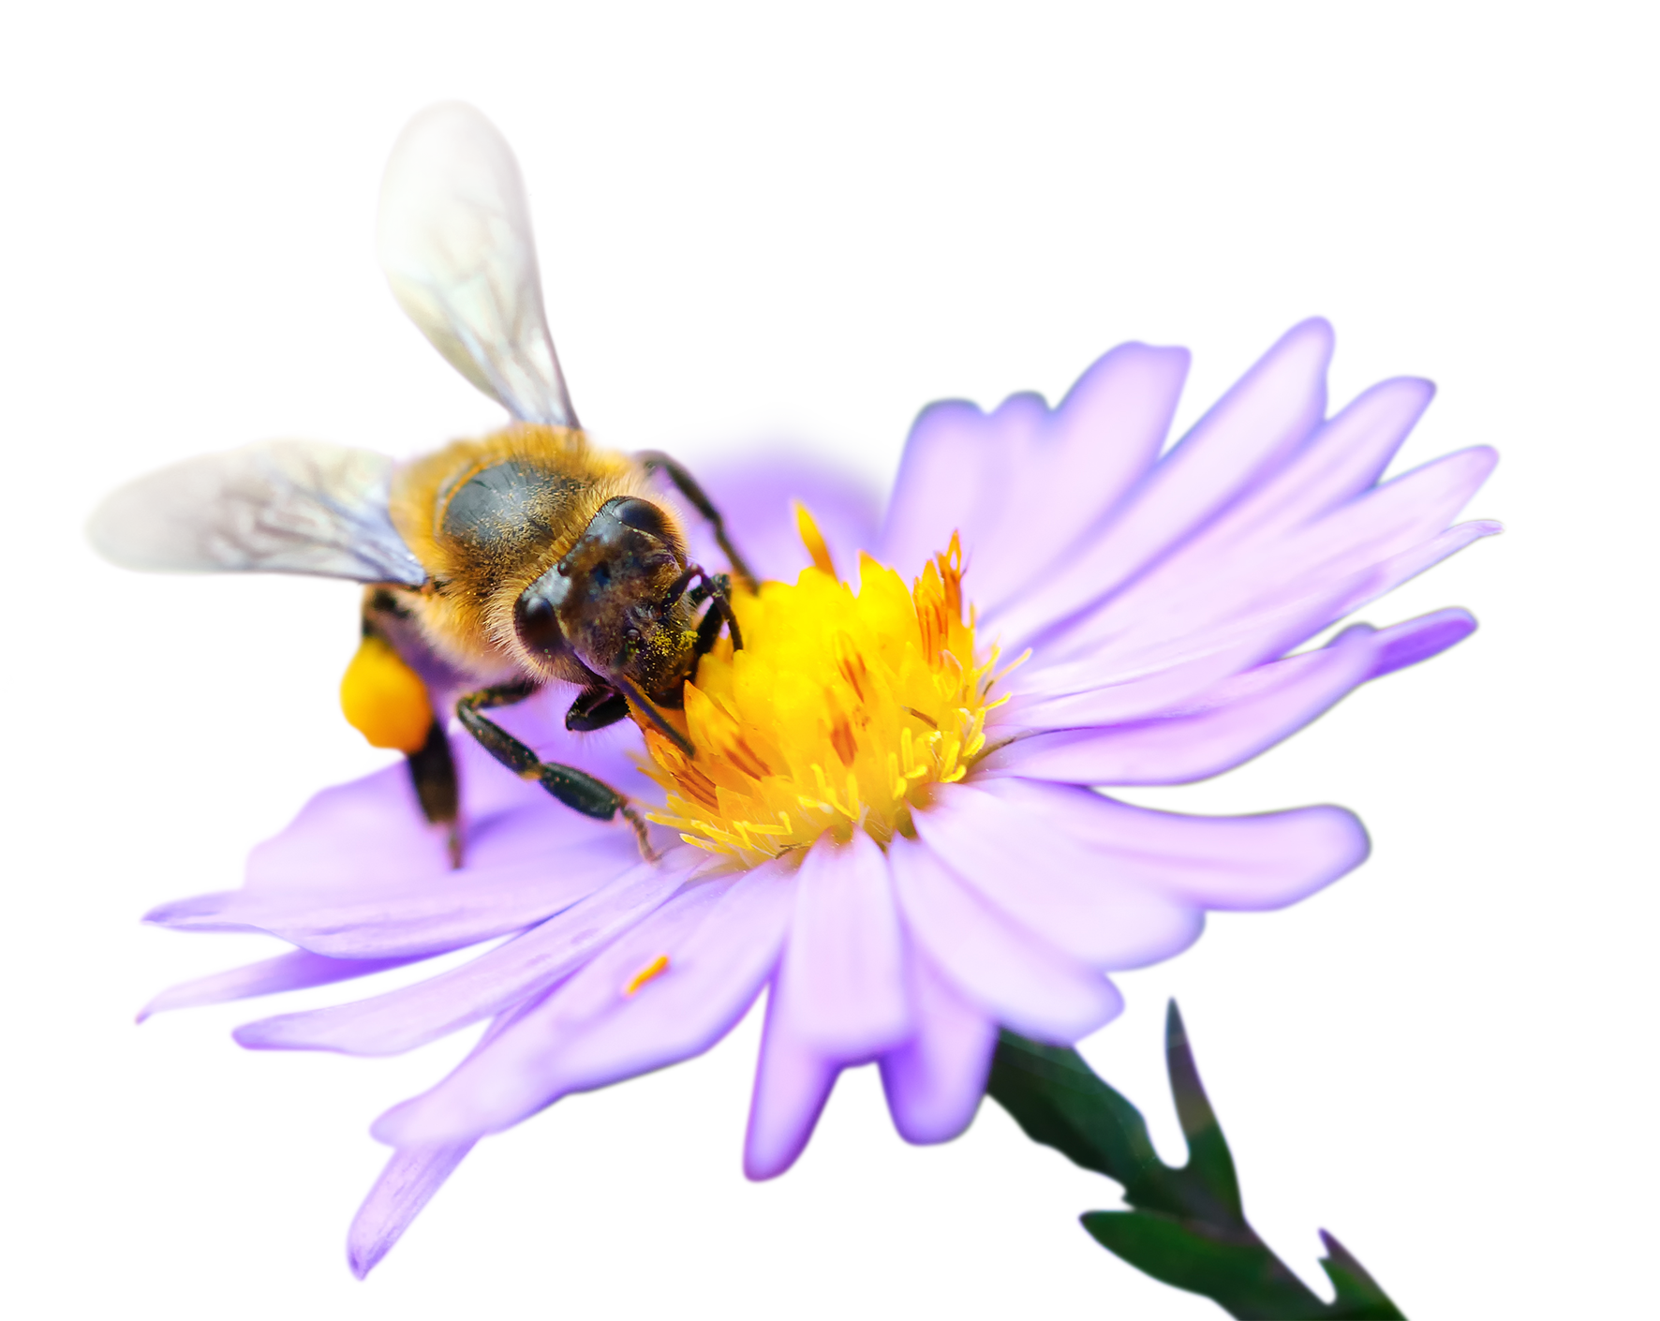
Interdependence and pollination
Aim:
To understand how communities of organisms are interdependent on each other through processes such
as pollination, and how humans rely on this.
Do now:
Can you think of five or more animals that pollinate?
Page 2 of 10 | Interdependence and pollination

Slide 3
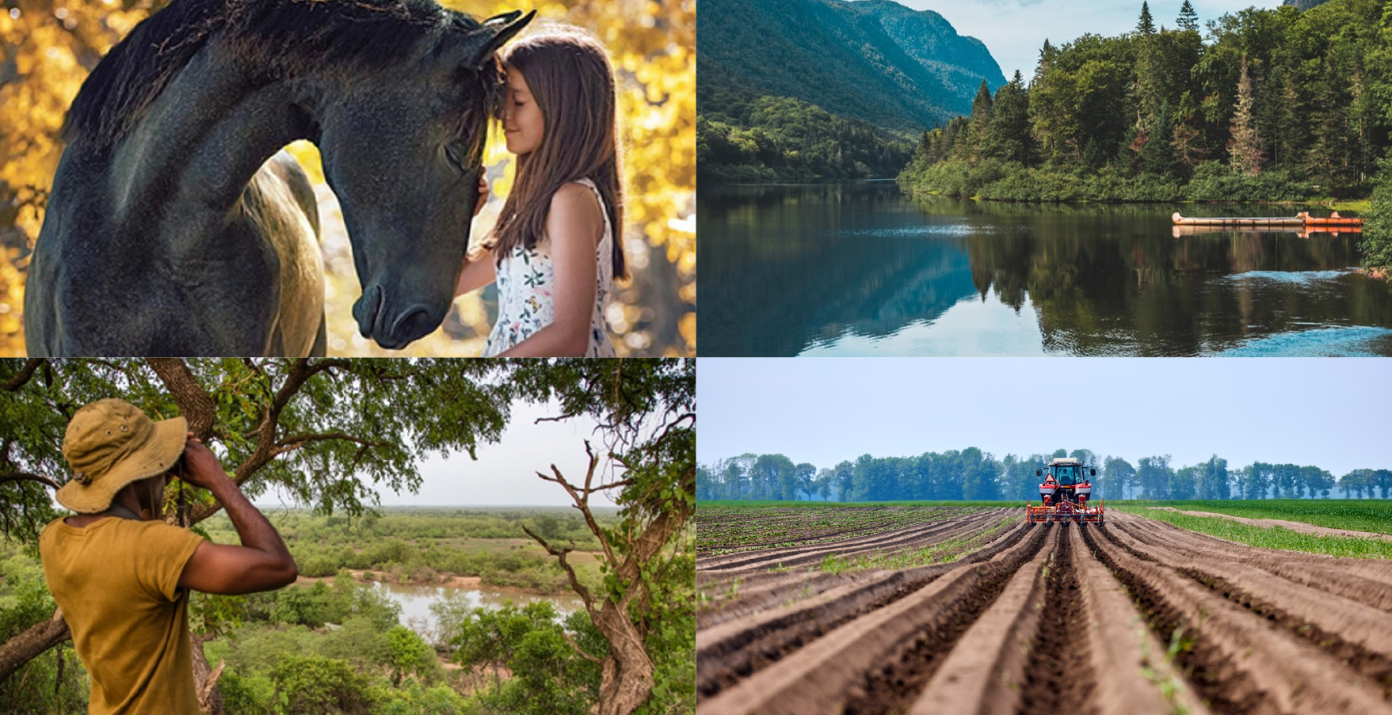

Starter
Mind map: How are humans reliant on nature?
Page 3 of 10 | Interdependence and pollination

Slide 4
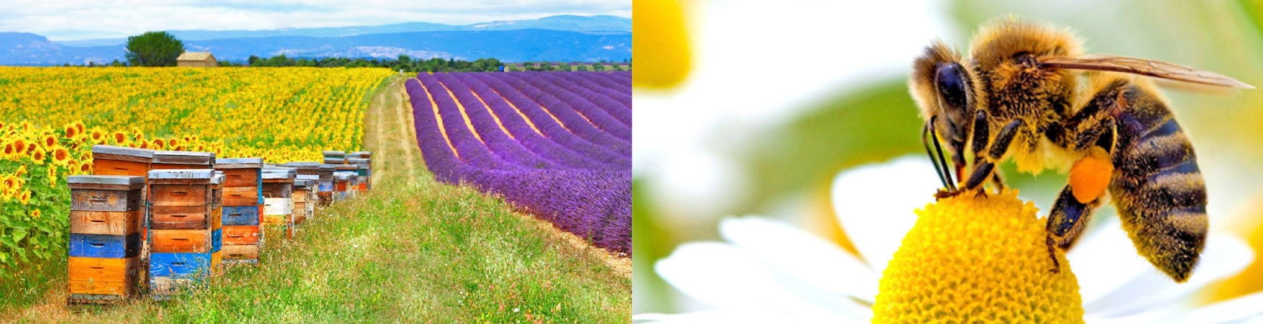
Interdependence
Organisms depend on each other for survival.
This is called interdependence.
For example, bees rely on flowers to provide them with nectar and pollen for food, but the plants rely on the bees to take pollen from one plant to the next so they can reproduce.
Page 4 of 10 | Interdependence and pollination

Slide 5
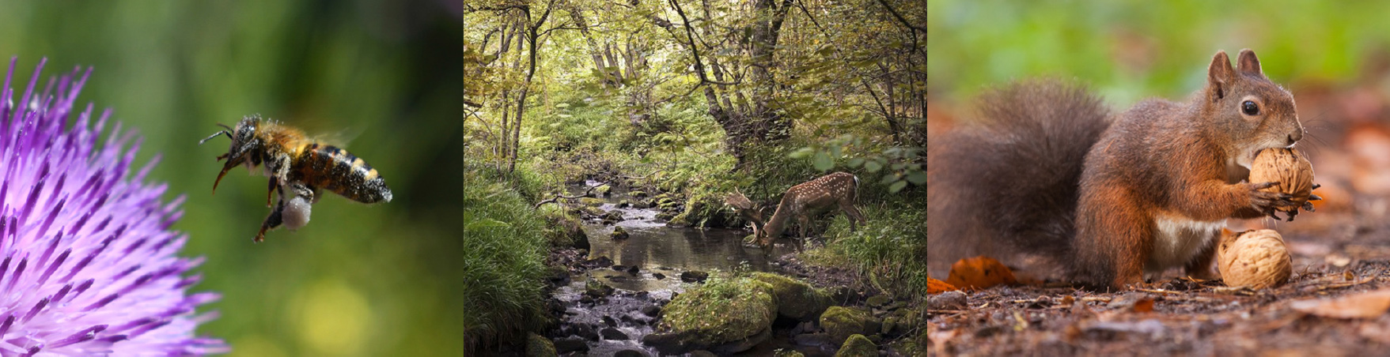
Examples of interdependence
1. Using the images, describe three examples of interdependence in nature.
2. Write your own definition of the word.
Challenge: What would happen if one of these elements was taken away?
Page 5 of 10 | Interdependence and pollination

Slide 6
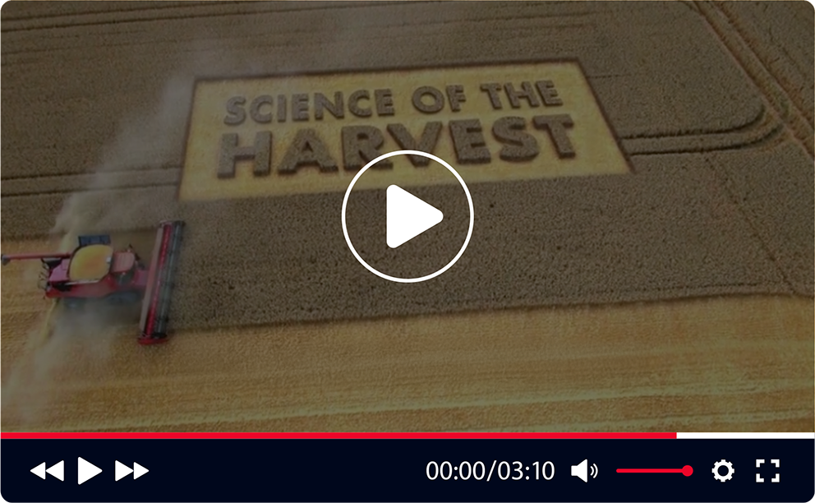

Why do we rely on pollination?
1. Why do plants rely on animals to help the reproduce?
2. Why do humans rely on pollination?
3. How do you think the world would be
different if pollinating insects like bees
suddenly disappeared?
www.bbc.co.uk/teach/class-clips-video/biology-ks3-ks4-science-of-the-harvest-pollination-fruit-harvest/zd8py9q
Page 6 of 10 | Interdependence and pollination

Slide 7
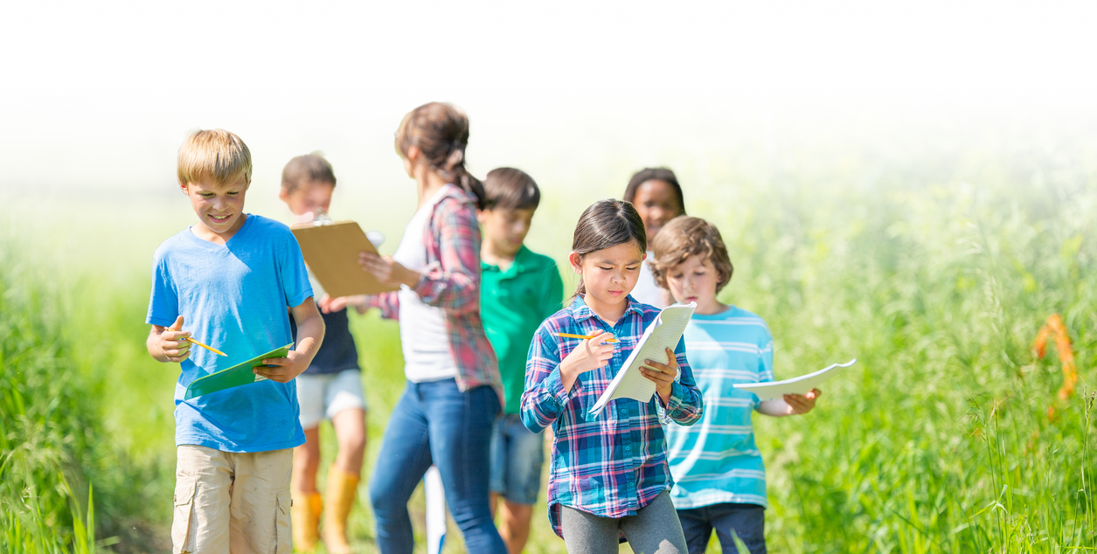
Practical activity
Go outside for 20 minutes and complete the sheet in as much detail as you can.
Feedback on the next slide!
Page 7 of 10 | Interdependence and pollination

Slide 8
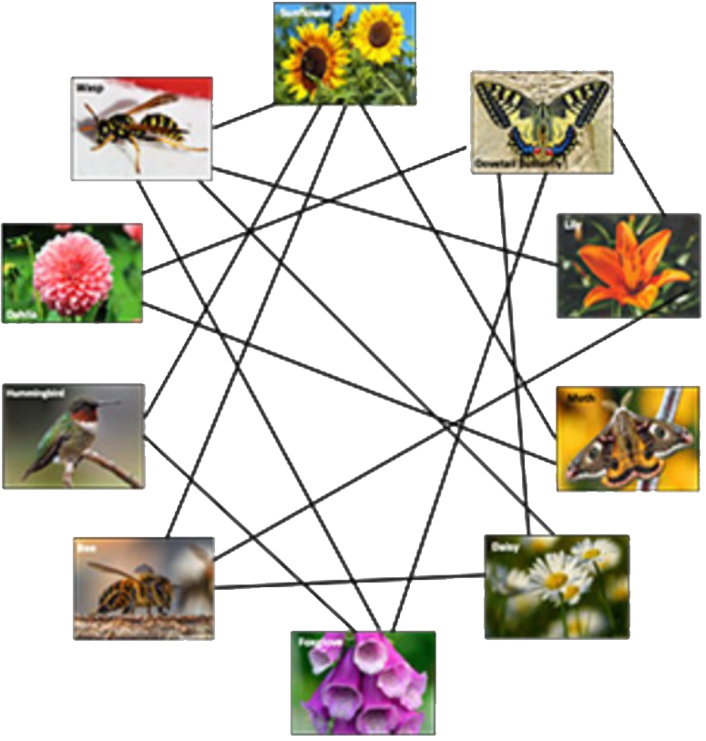
Interdependence activity – outdoor worksheet
Stinging Nettle
Bumblebee
Fruit
Common Fly
Pollen
Oak tree
Pollen
Butterfly
Ants
Honeybee
Flowering plants
Feedback: What did we discover?
Who managed to link all the elements together? Did anyone come up with some good ideas for the challenge?
Page 8 of 10 | Interdependence and pollination

Slide 9
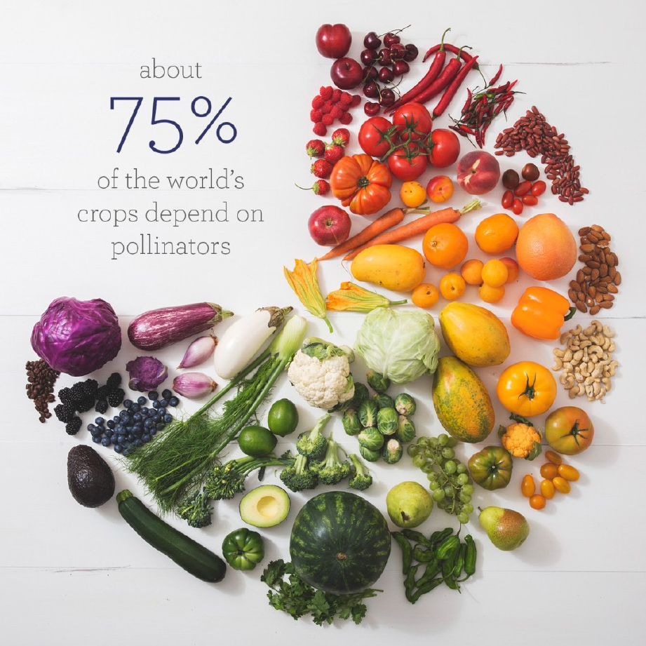
Plenary
Did you know?
To do: Write a paragraph describing what could happen to the world if bees and other pollinators disappeared.
What would be the long-term consequences? How would food security be impacted? What would happen to trade? Would there be wars? Which countries might do better?
Key terms to use: Pollinators, pollination, food security, interdependence, ecosystem.
Page 9 of 10 | Interdependence and pollination

Slide 10

Page 10 of 10 | Interdependence and pollination

