Slide 1

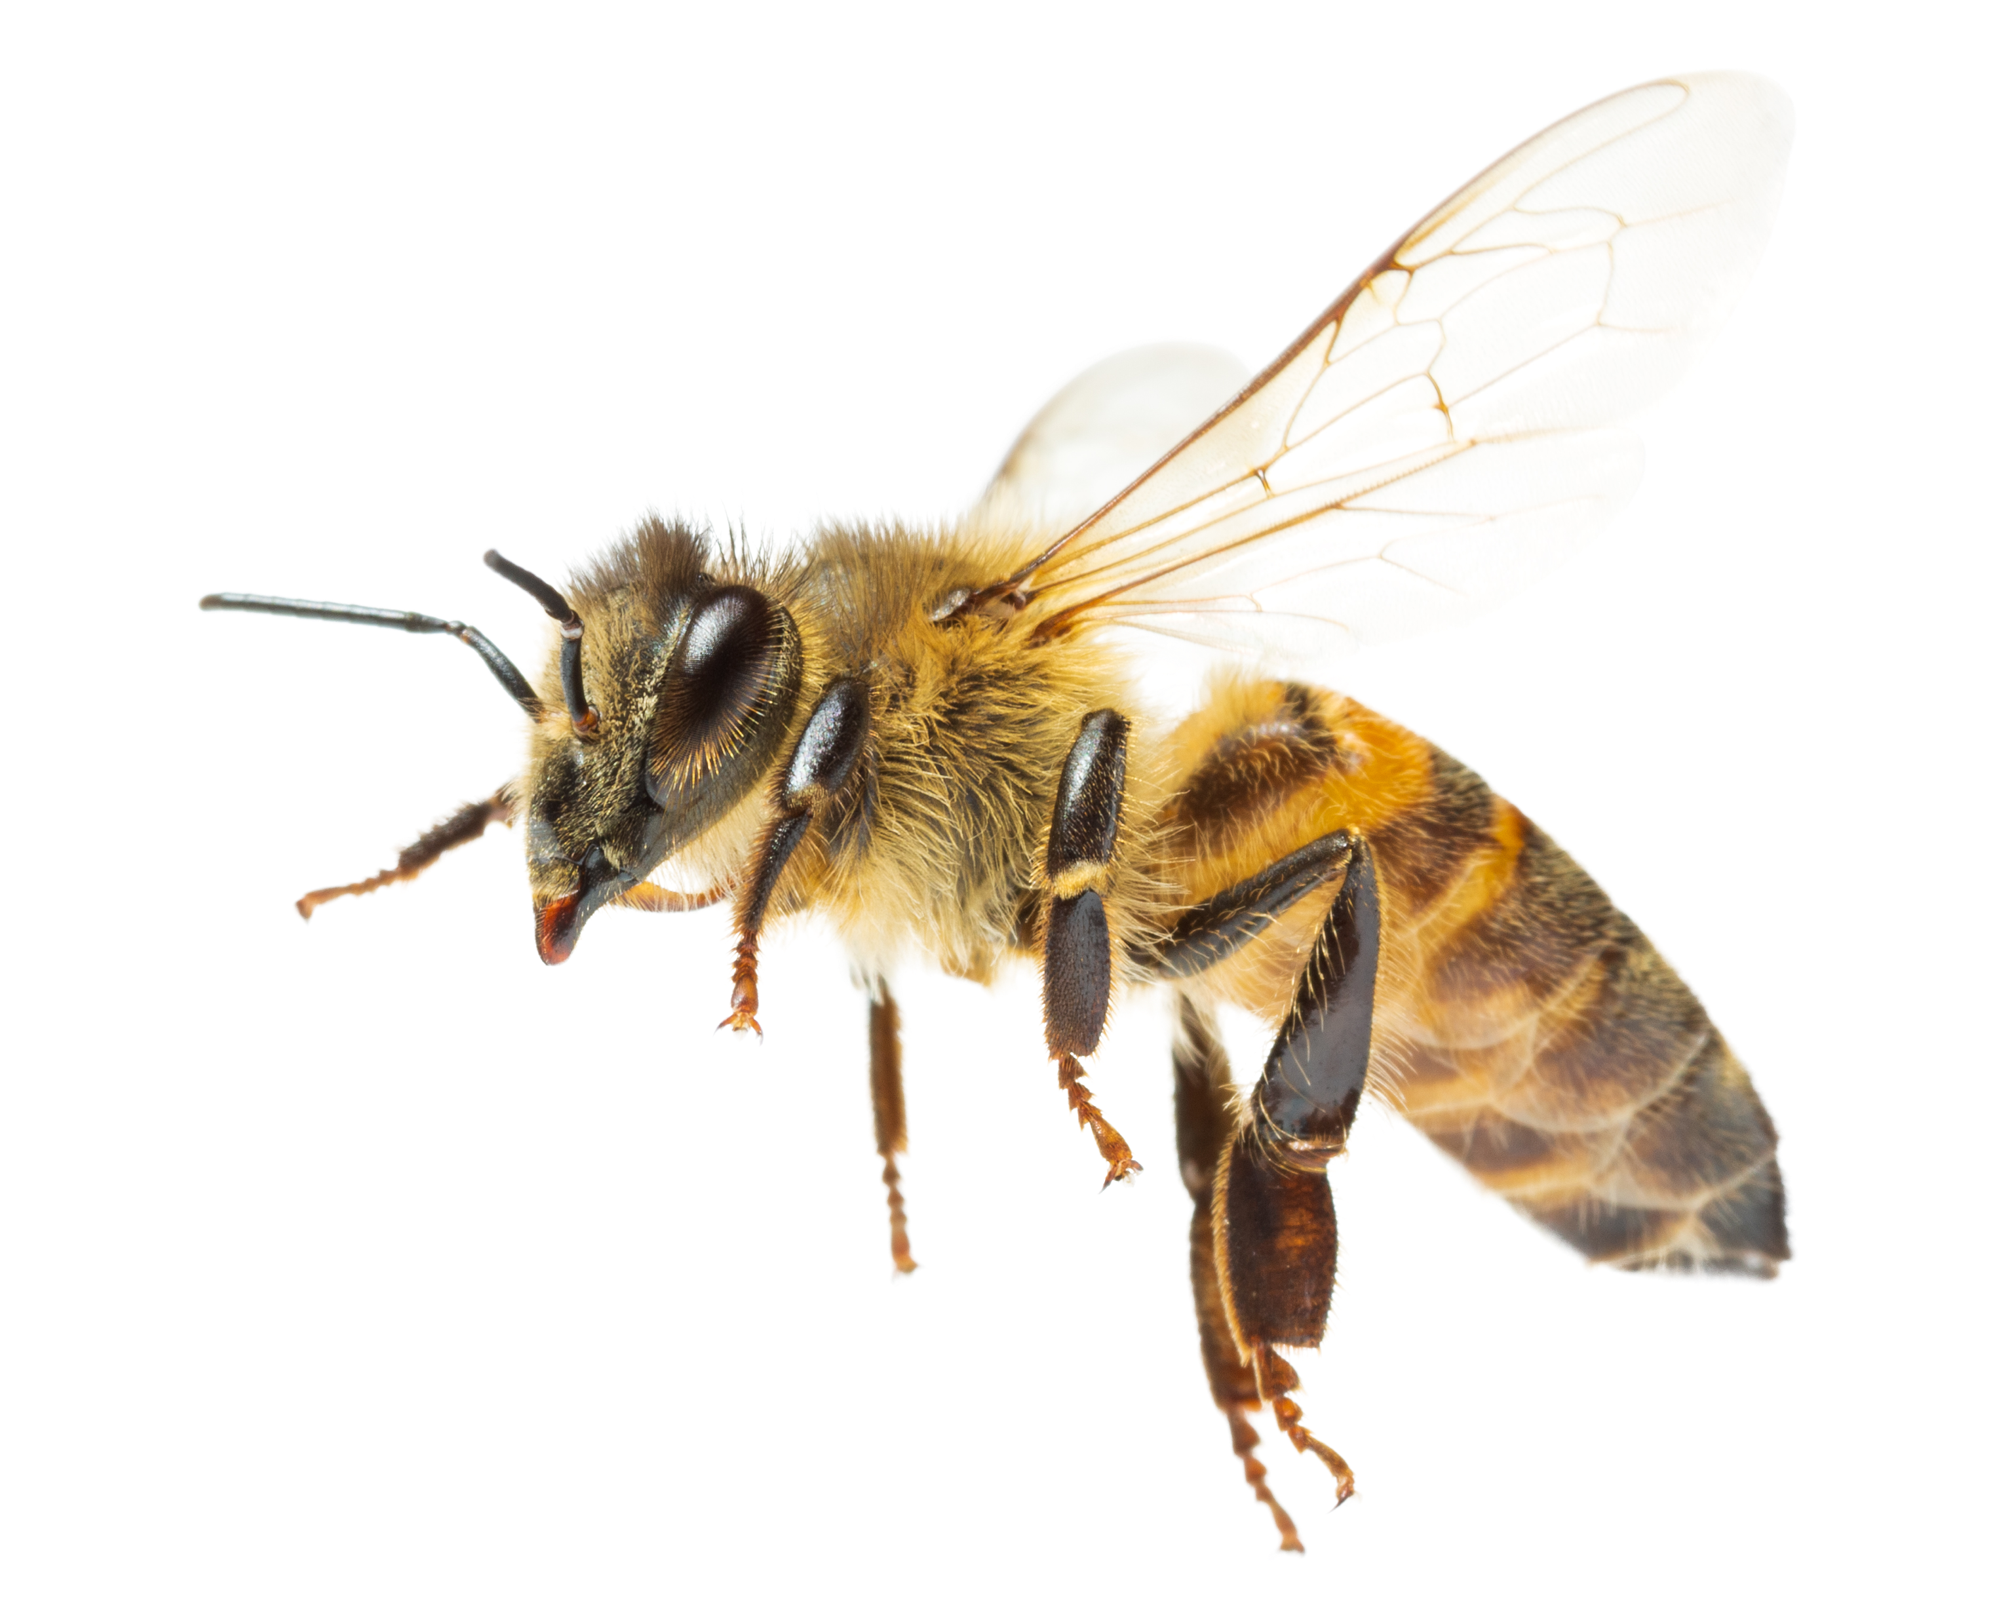
Make a pollinator finger puppet
A session from
the Ecology Service supporting the
Bee Superhighway
Page 1 of 8 | Make a pollinator finger puppet
Notes:
Resources needed
Black, yellow and white felt, scissors, glue, glue spreaders, googly eyes

Slide 2
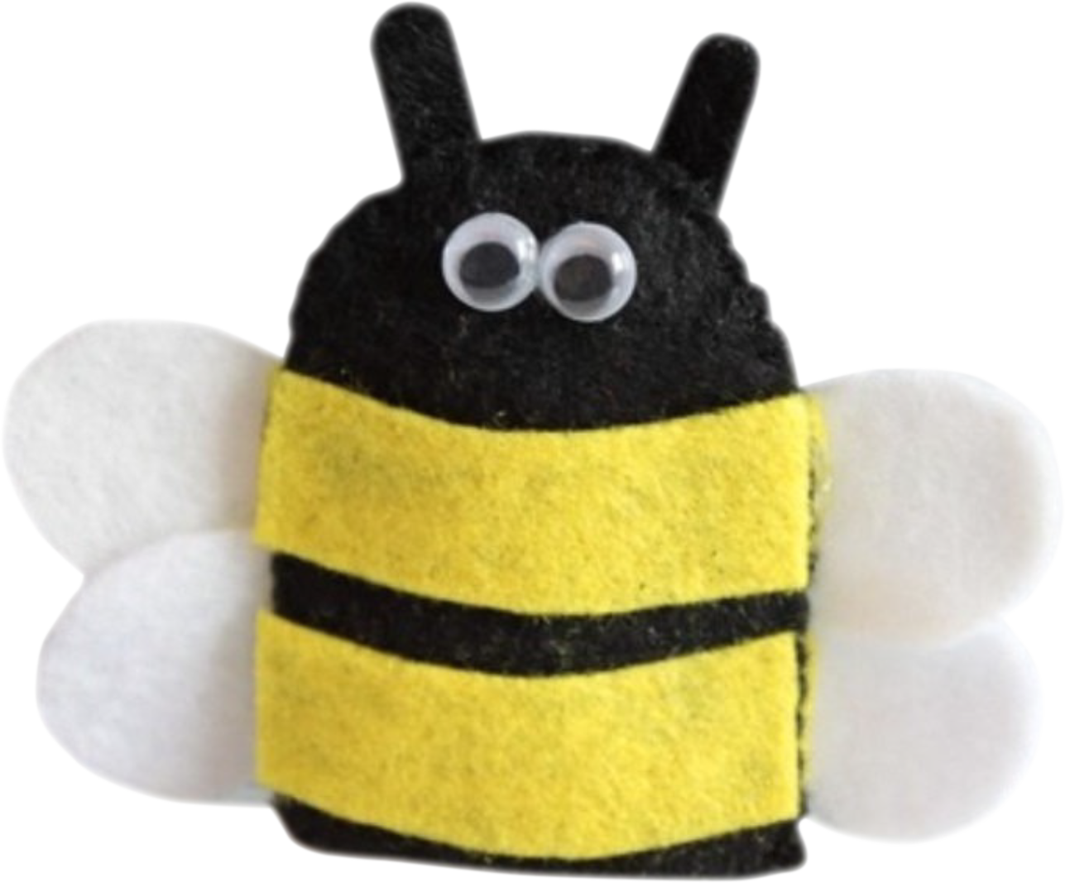
Can you make a pollinator finger puppet like this one?
This is a bumblebee, but you could make a different one if
you like.
Page 2 of 8 | Make a pollinator finger puppet

Slide 3


Step 1
Cut out three pieces of felt in this shape. Make sure they match and are at least three times wider than your finger.
Piece A
Piece B
Piece C
Min. width
x3
Page 3 of 8 | Make a pollinator finger puppet

Slide 4


Step 2
Use scissors to cut the stripes
Glue these pieces down
Piece C
Cut stripes out of yellow felt and stick them on
the black piece.
Page 4 of 8 | Make a pollinator finger puppet

Slide 5


Step 3
Cut out two heart shaped pieces from white felt for the wings and place them between the upper and lower layers of black pieces.
Cut out two shapes like this
Place them between black pieces
Page 5 of 8 | Make a pollinator finger puppet

Slide 6

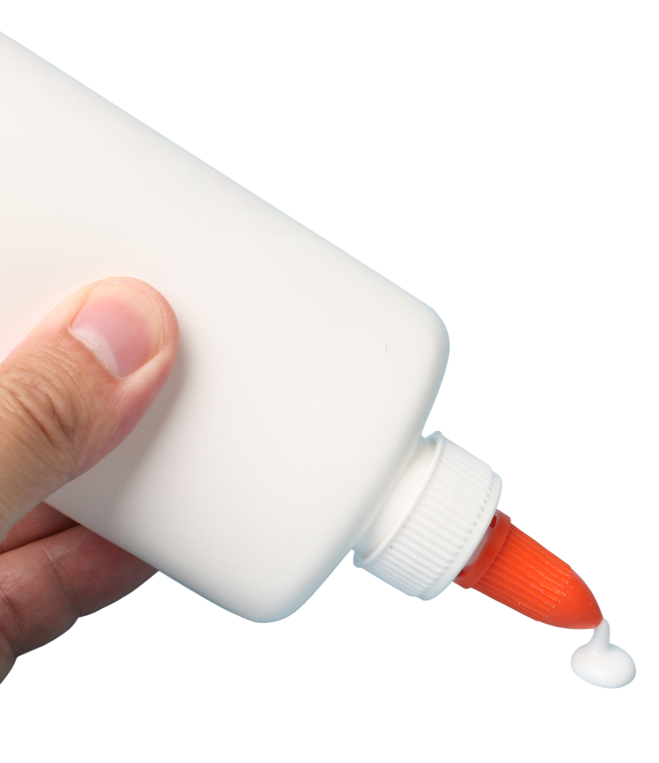
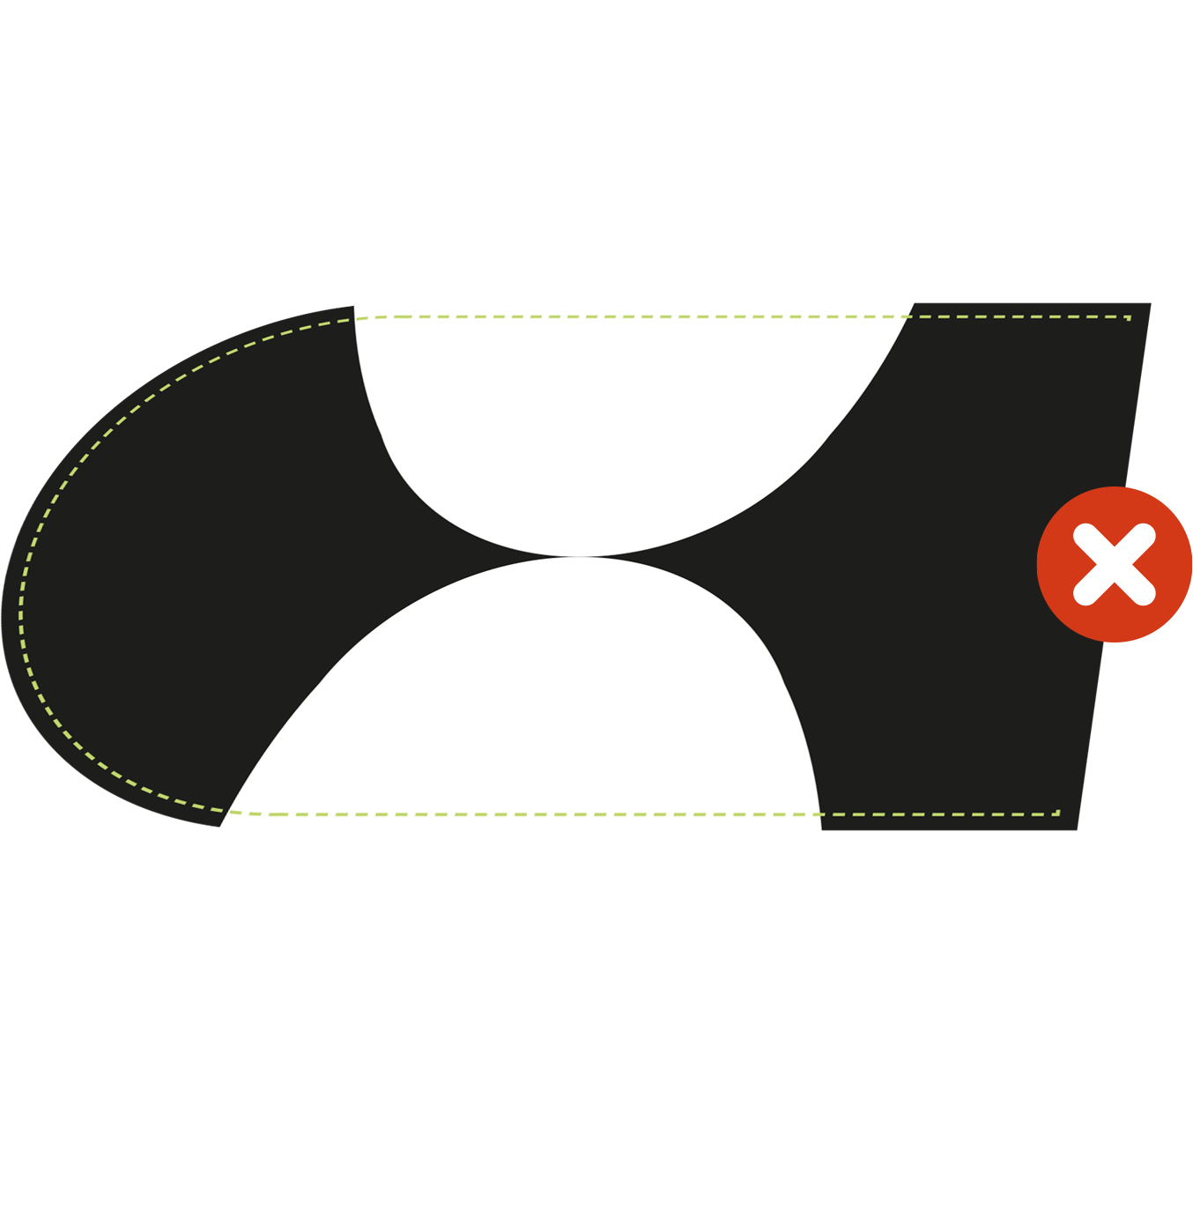
Step 4
A felt piece with the stripes goes on the top
Now glue all around the edge except for the bottom and stick the upper and lower layers together.
Glue
around the
edge only
Don’t glue the bottom edge
Page 6 of 8 | Make a pollinator finger puppet

Slide 7
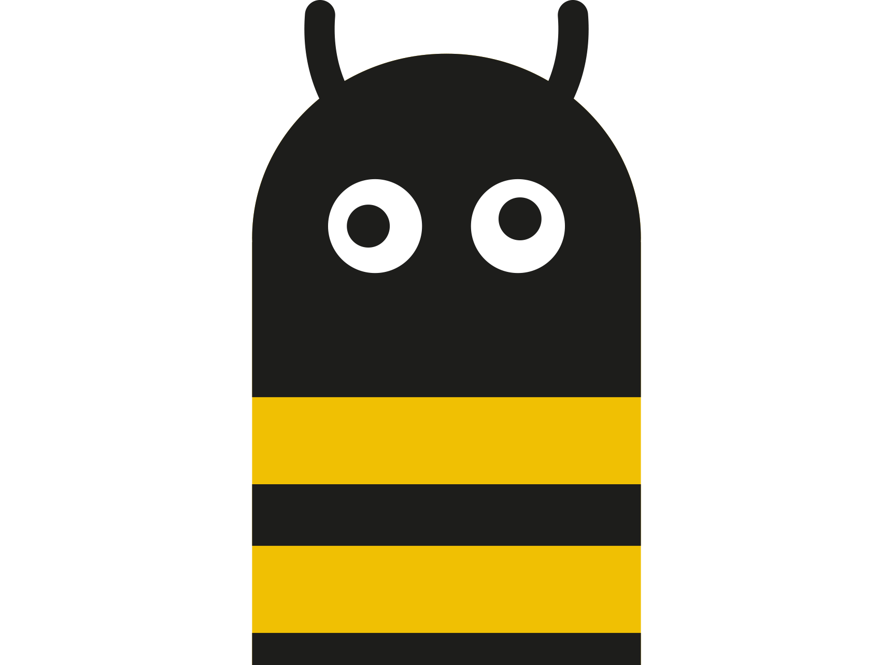
Step 5
Glue on googly eyes and cut out and add antennae.
Your puppet is now finished!
What else could you add? ☺
Page 7 of 8 | Make a pollinator finger puppet

Slide 8

Page 8 of 8 | Make a pollinator finger puppet

