Slide 1

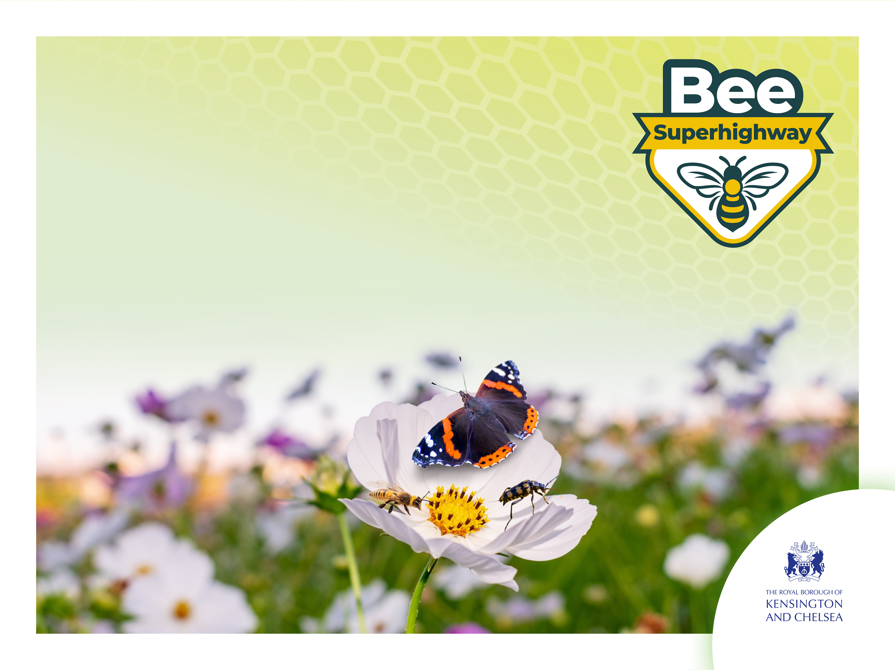
What is a pollinator?
A session from the ecology service supporting the Bee Superhighway
Page 1 of 13 | What is a pollinator?

Slide 2
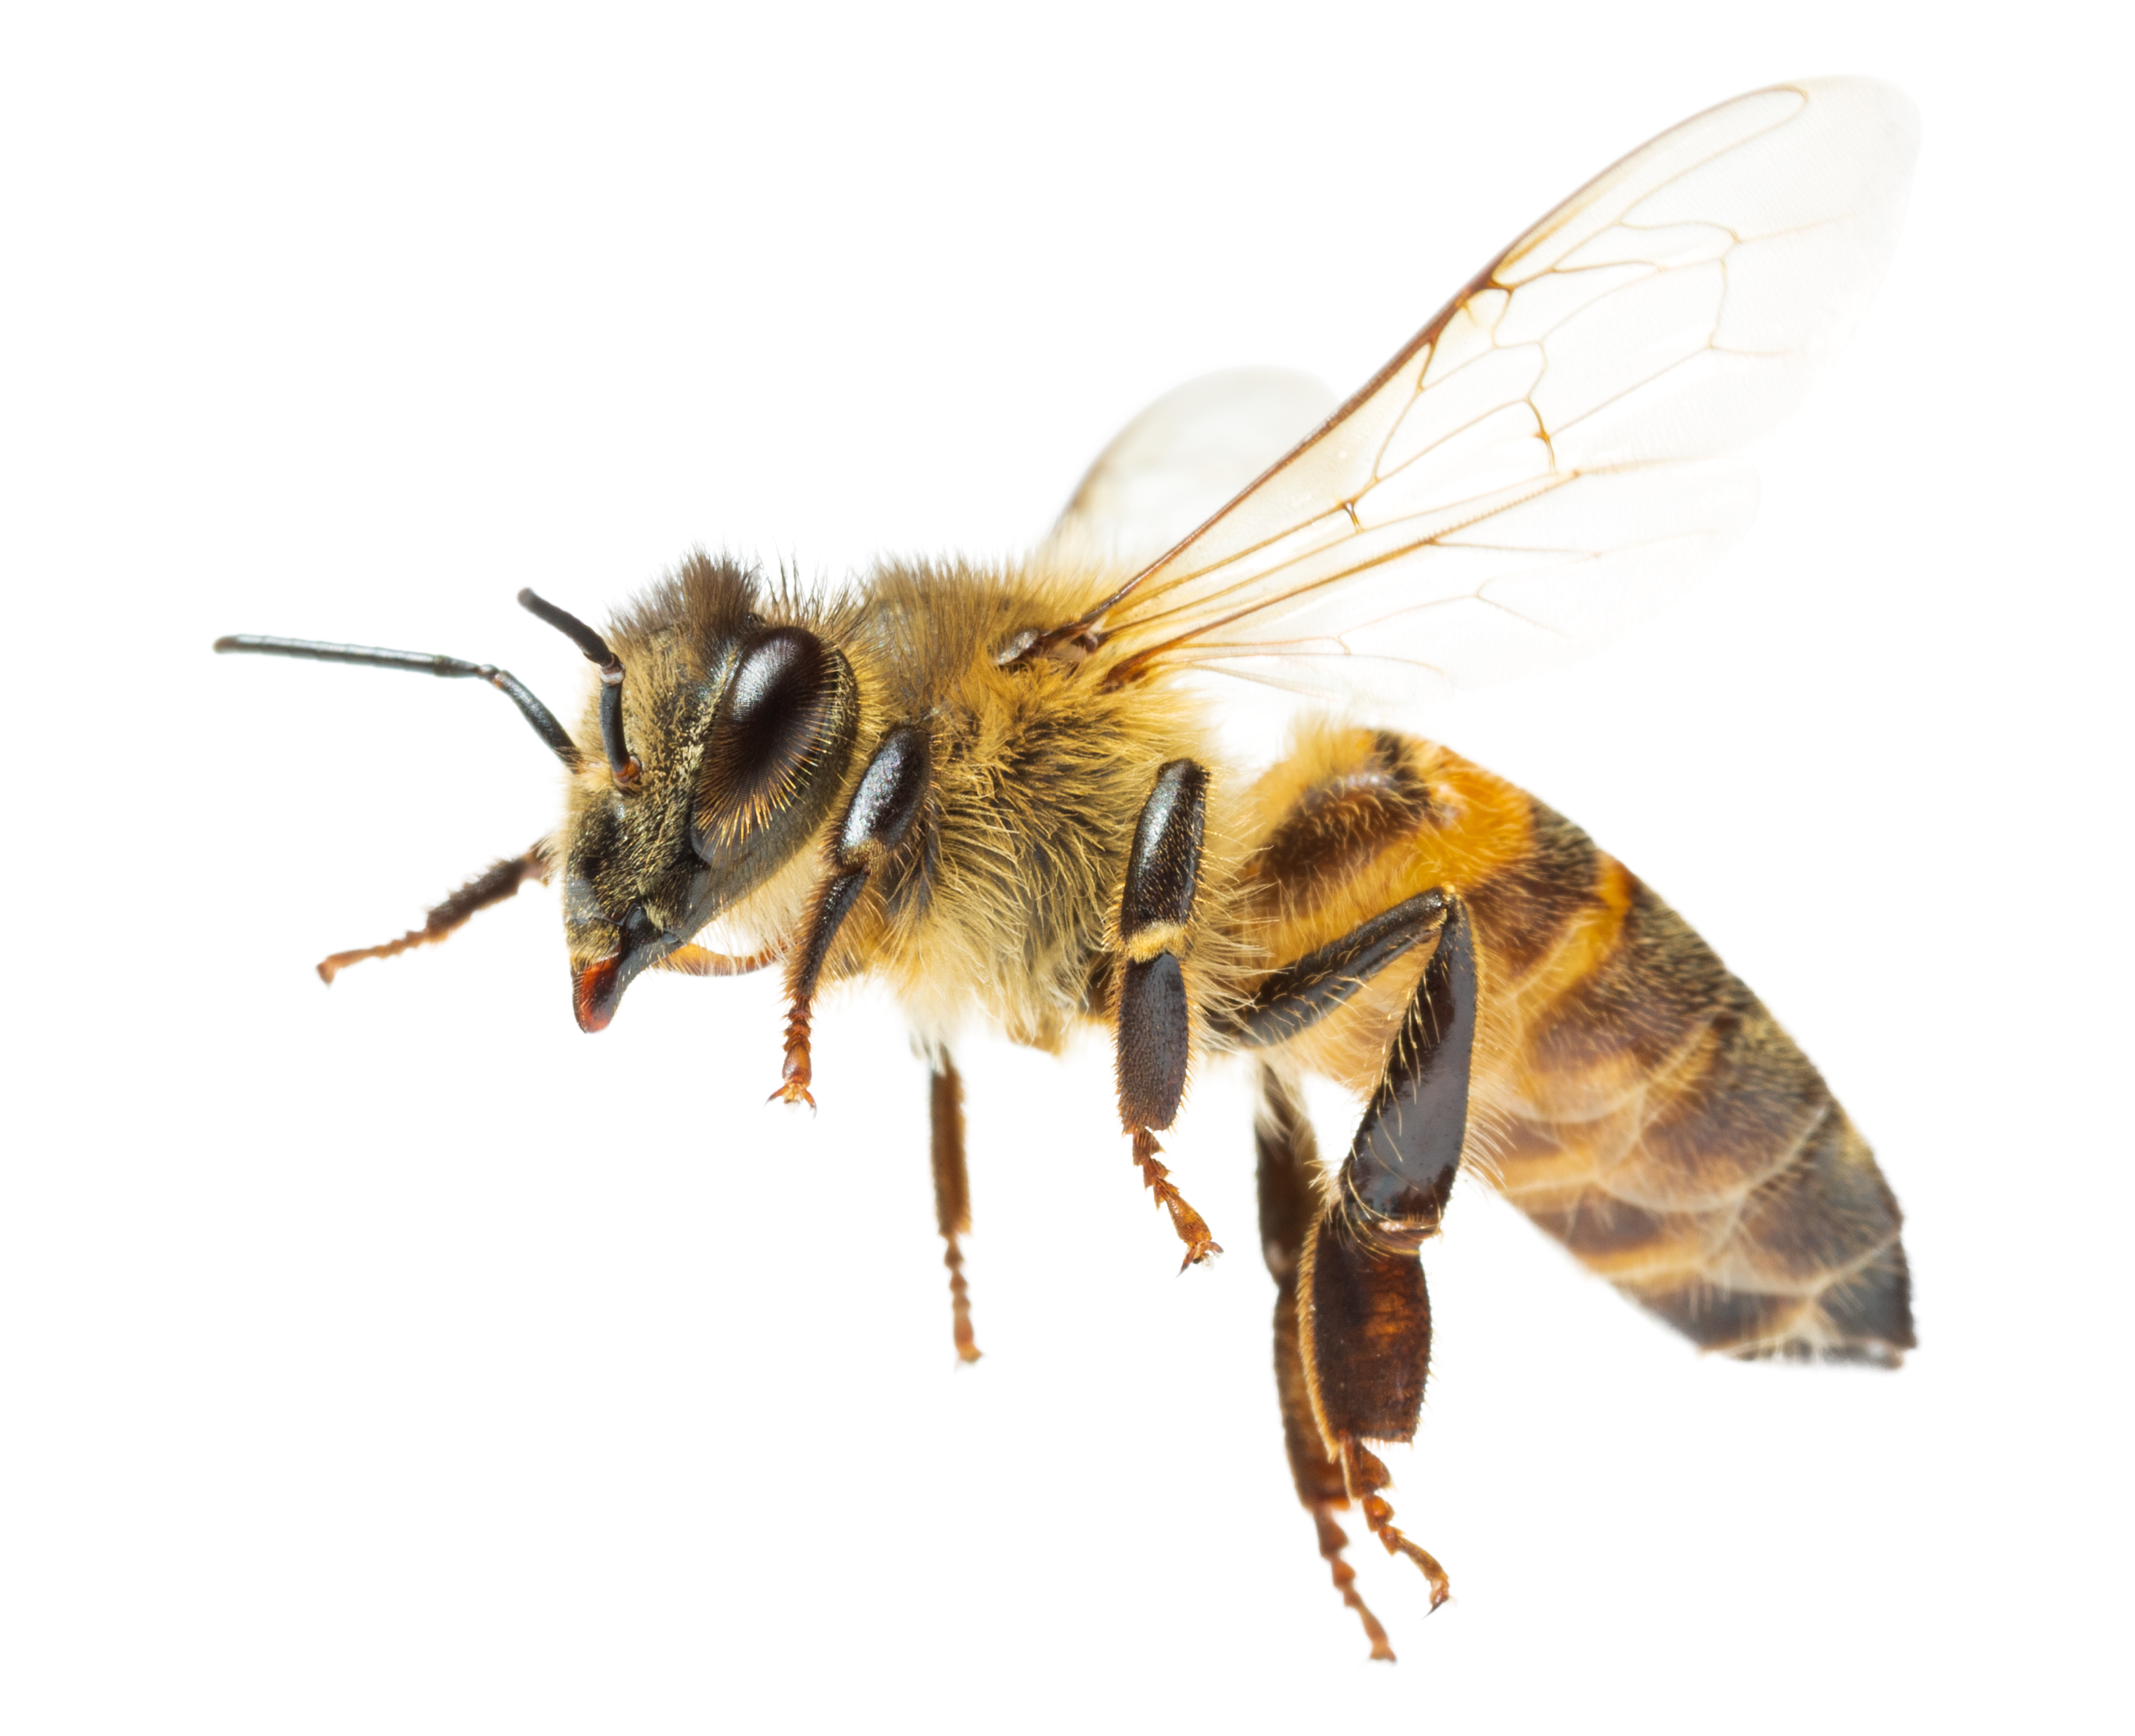
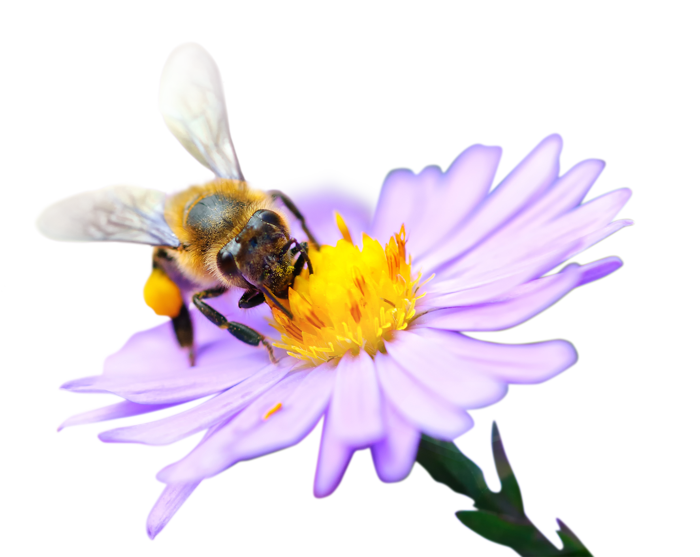
What is a pollinator?
Pollinators are animals that help plants to create seeds.
They take pollen from one flower to another.
Page 2 of 13 | What is a pollinator?

Slide 3
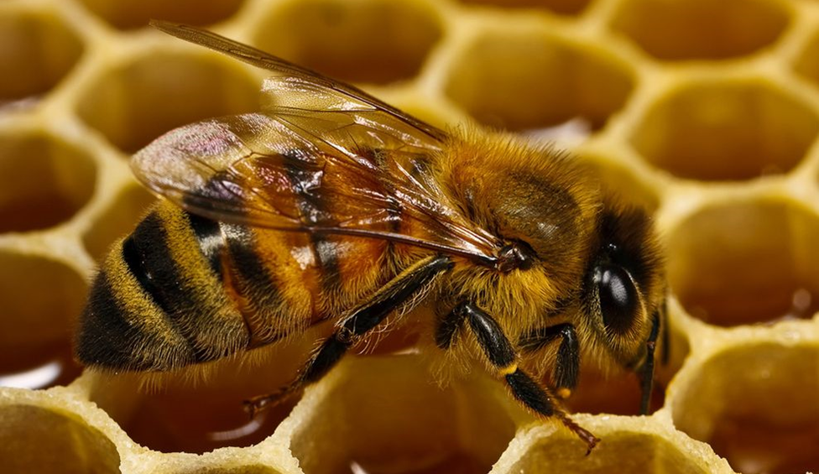


Bees are pollinators
Page 3 of 13 | What is a pollinator?
Notes:
The photo shows a Honeybee

Slide 4
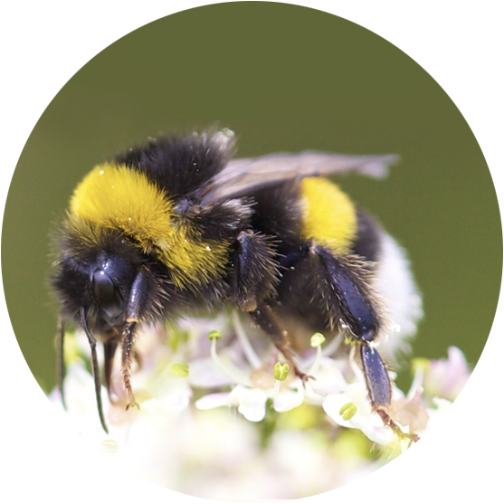
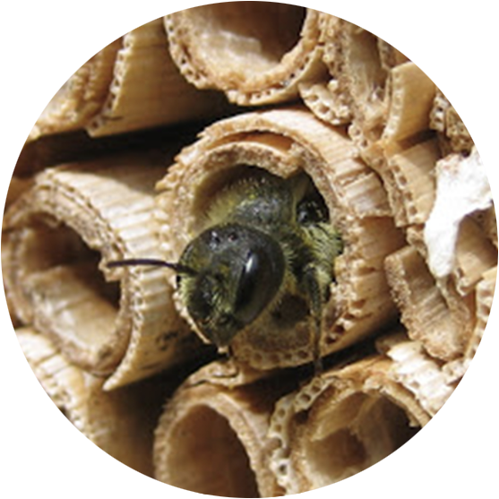
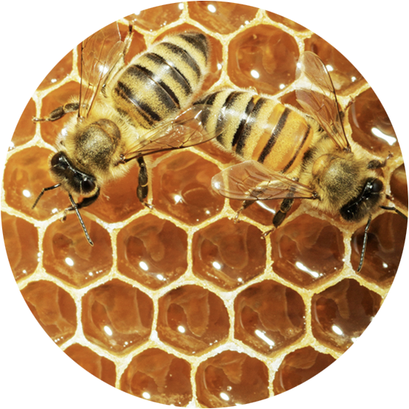
There are lots of different types of bees…
Fun fact: There are around 20,000 described bee species worldwide. In Britain we have around 270 species of bee, just under 250 of which are solitary bees.
Page 4 of 13 | What is a pollinator?
Notes:
From l-r: a species of bumblebee, a species of solitary bee, Honeybees

Slide 5
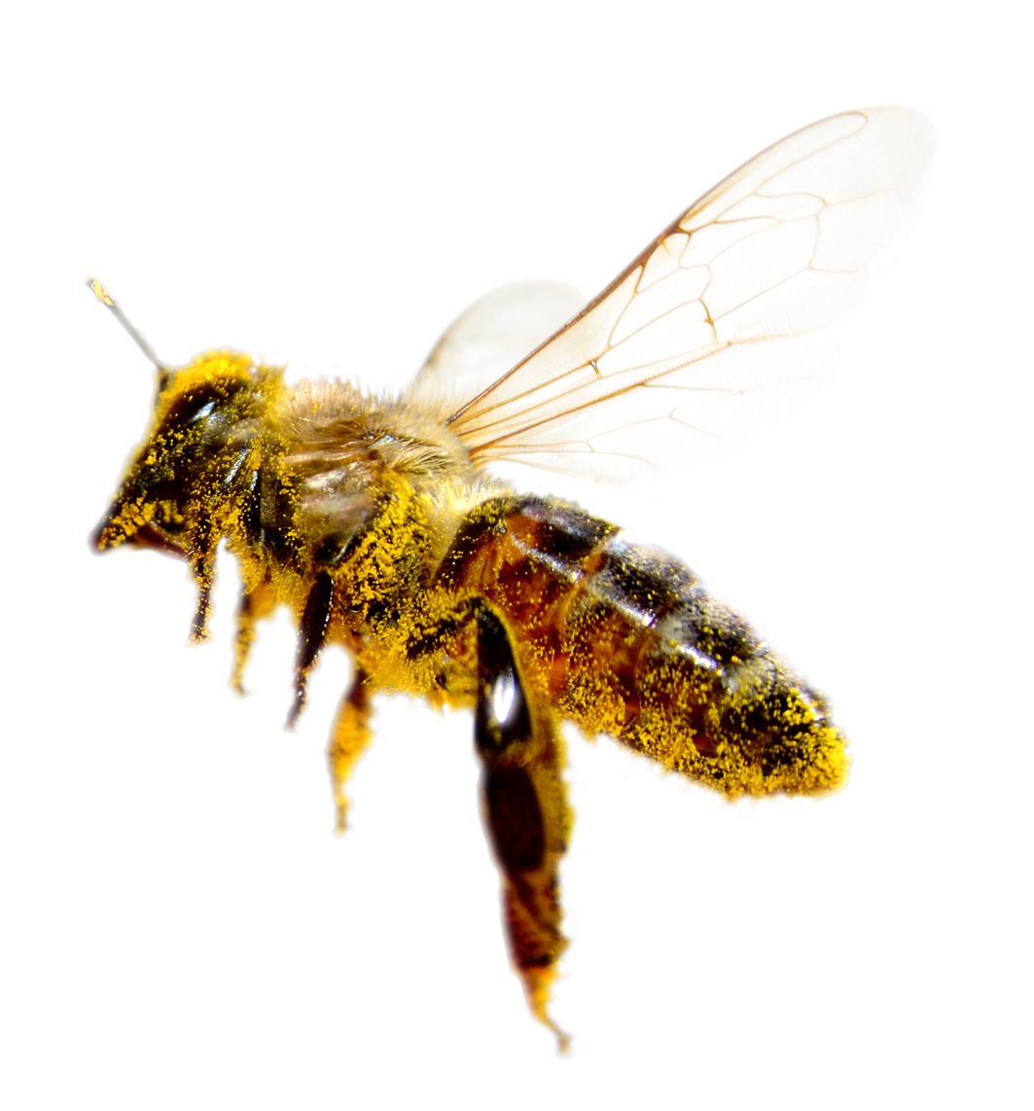
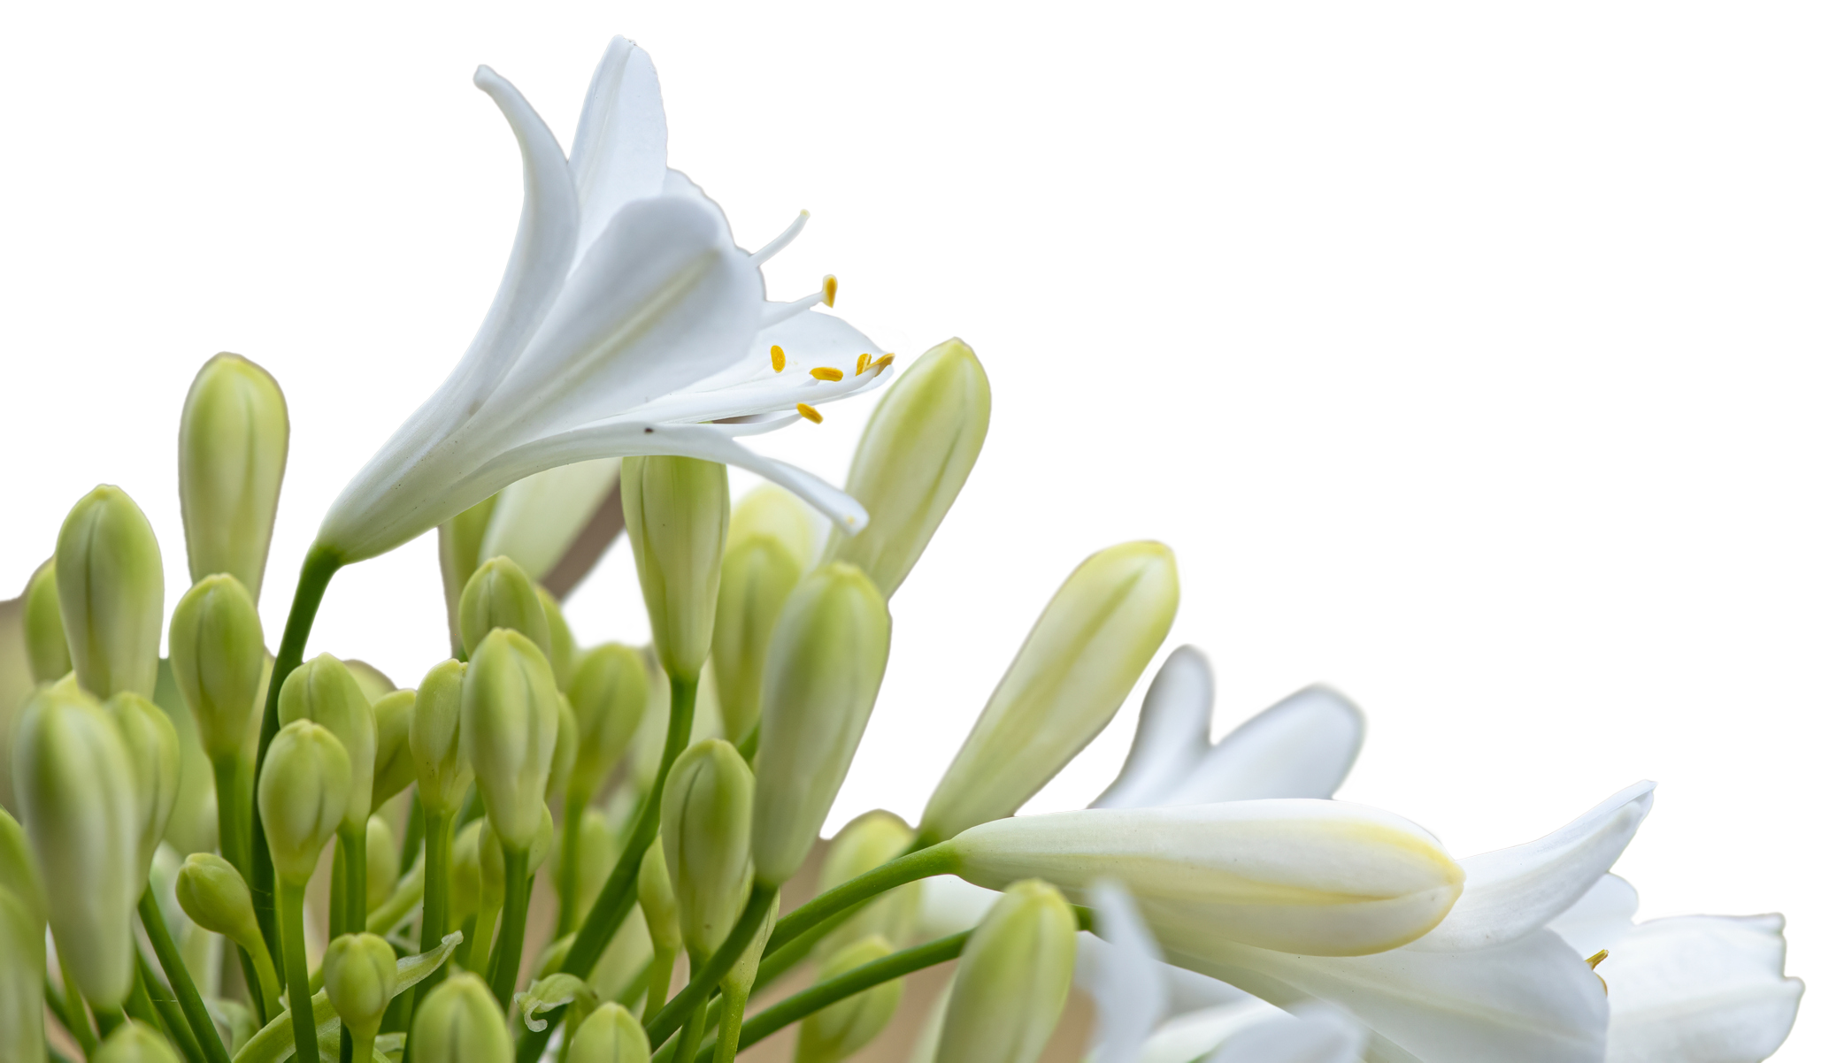
Bees collect pollen
Page 5 of 13 | What is a pollinator?
Notes:
Ask: can you see the pollen all over the bee’s body?
Bees collect pollen for food and in doing so accidentally carry it from one flower to another.

Slide 6
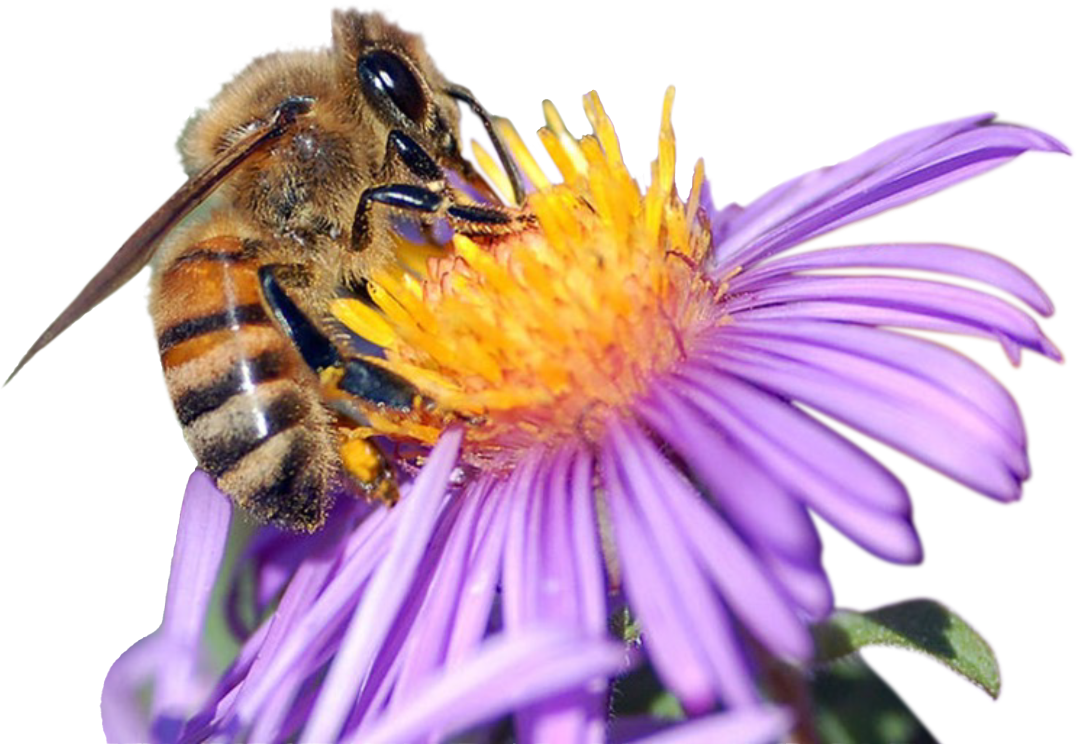
What is pollination?
It means taking pollen from one flower to another.
Page 6 of 13 | What is a pollinator?

Slide 7
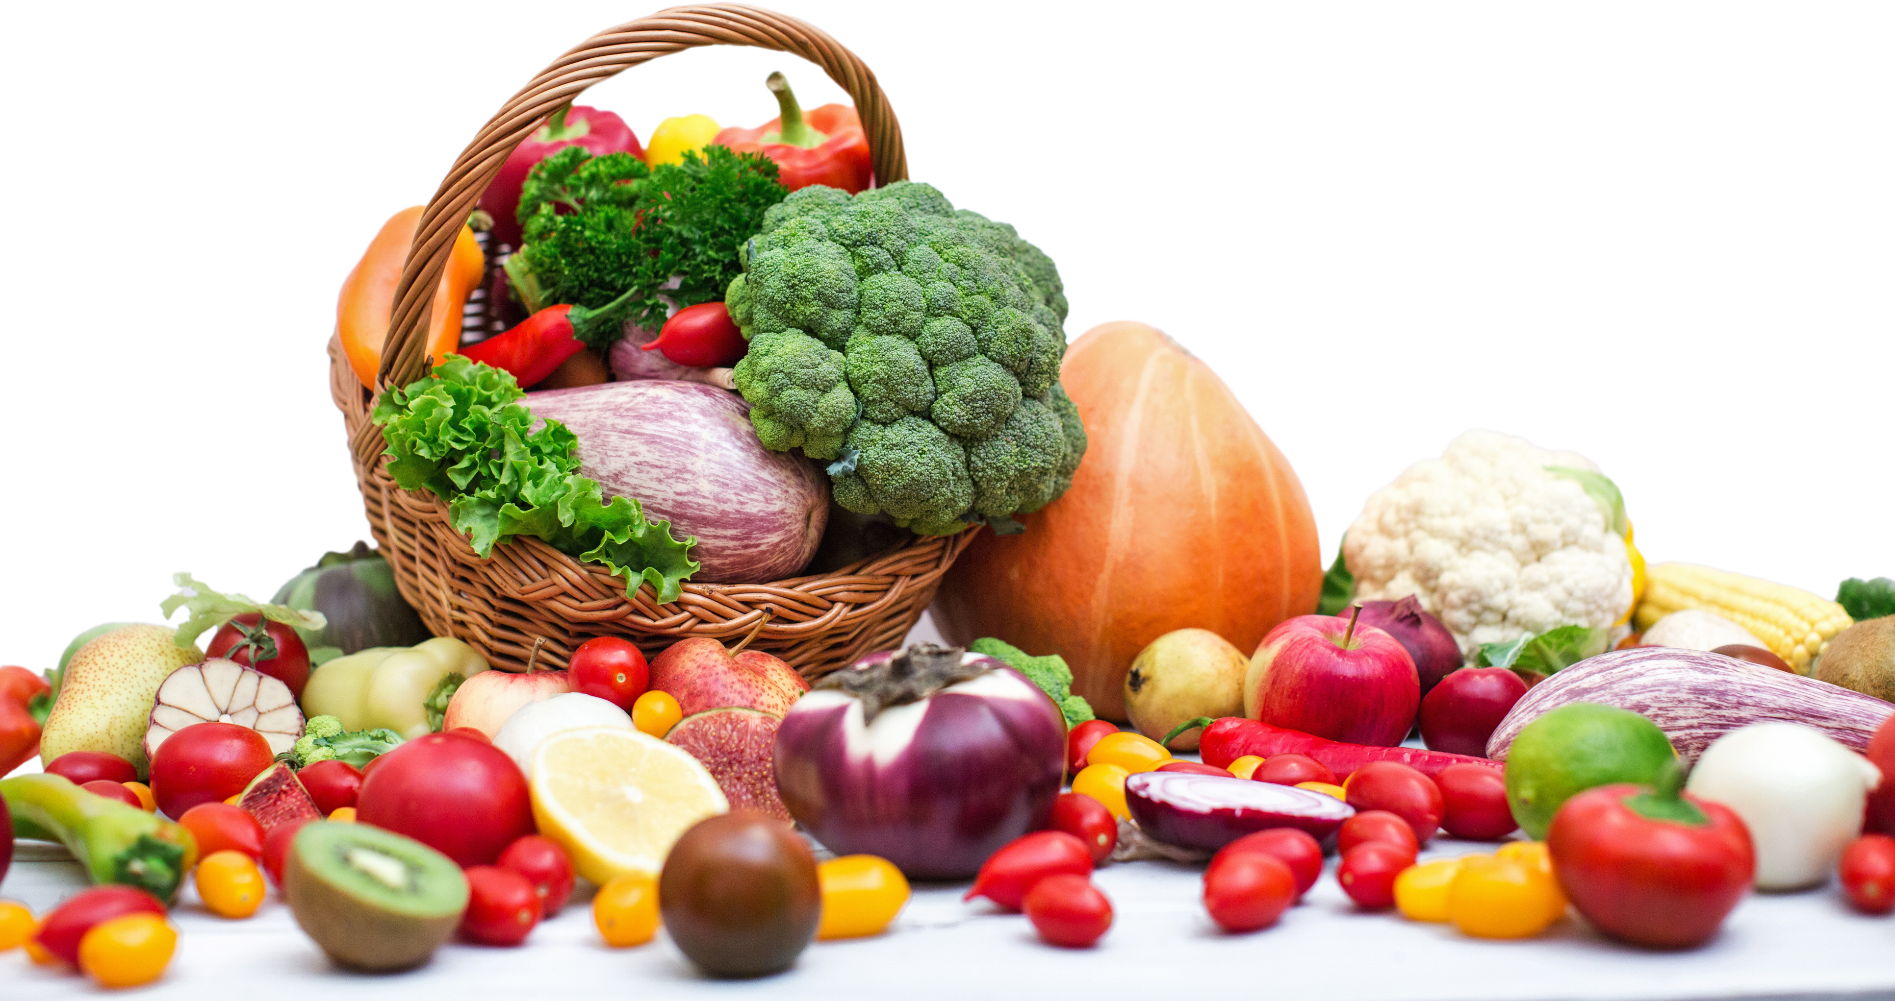
Pollination is important
1. Pollinators help plants to create seeds.
2. They take pollen from one flower to another.
3. Lots of the food we eat
needs pollinators.
Page 7 of 13 | What is a pollinator?

Slide 8

Are bees the only creatures that pollinate flowers?
Page 8 of 13 | What is a pollinator?
Notes:
Ask: can you think of any other animals that visit flowers?

Slide 9
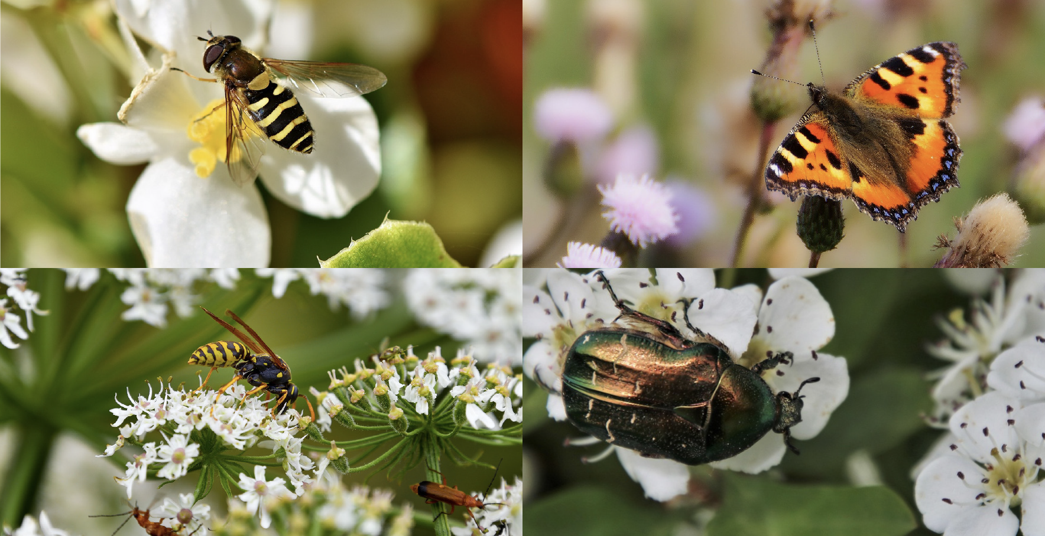
Other insect pollinators
Page 9 of 10 | What is a pollinator?
Notes:
Clockwise from top left: hoverfly, butterfly, beetle, wasp

Slide 10
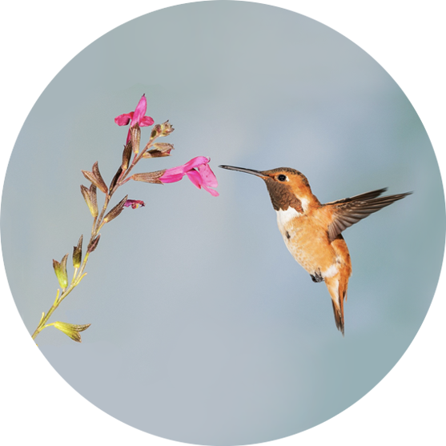
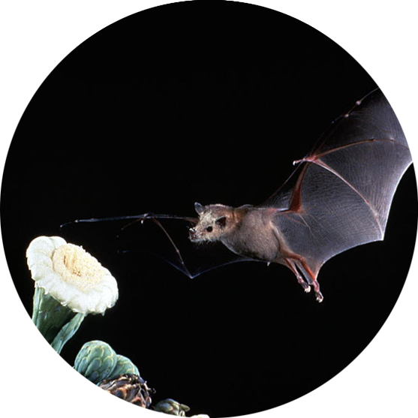
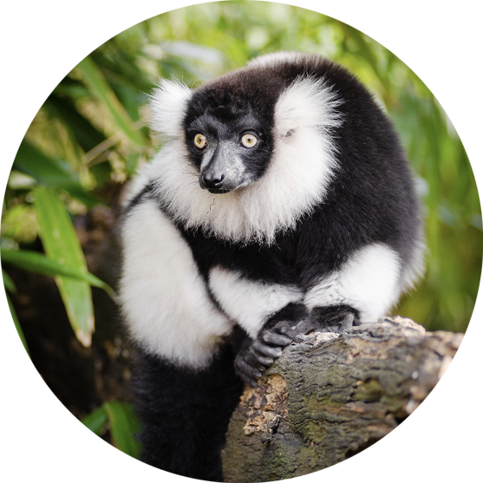
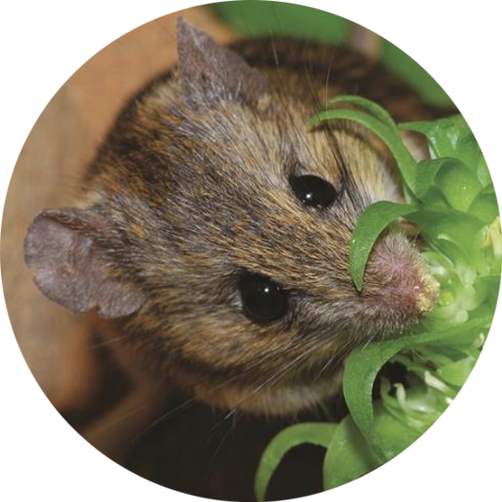
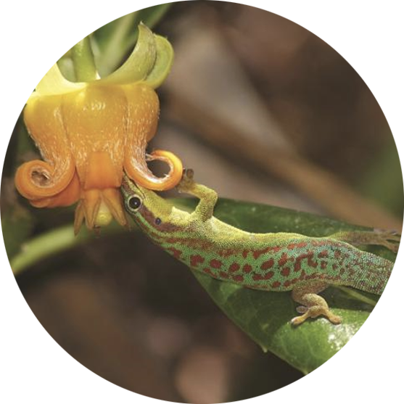
Other animal pollinators
In other parts of the world there are more unusual pollinators too!
Page 10 of 13 | What is a pollinator?
Notes:
Clockwise from top left: hummingbird, bat, lemur, lizard, bush rat

Slide 11
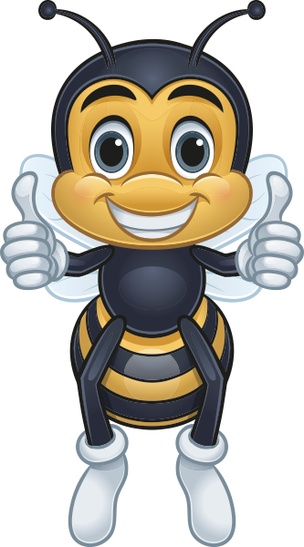

Help the pollinators
Three ways we can all help.
Page 11 of 13 | What is a pollinator?
Notes:
Ask: What ways can you think of to help pollinators?

Slide 12


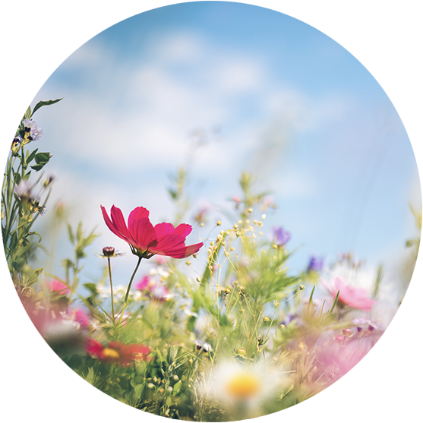
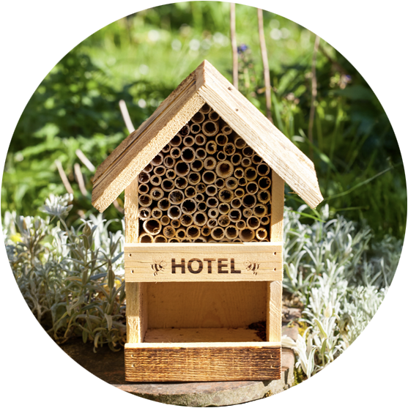
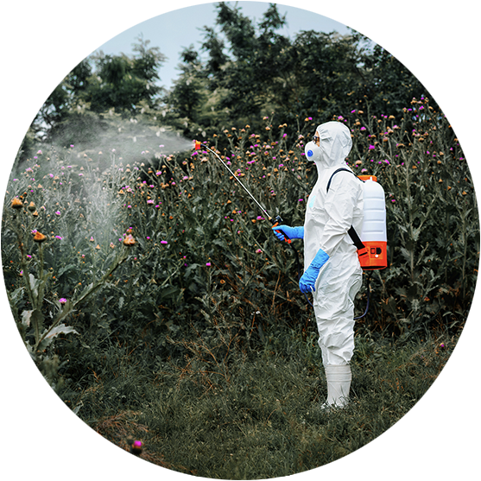
Please help the pollinators
Preservation of landscape fields and flowers
Bee hotels provide essential nesting and shelter for solitary bees
Stop use of herbicides and pesticides
Habitat loss and fragmentation are significant threats to bees.
Solitary bees struggle to find suitable habitats, especially in urban and agricultural areas.
Page 12 of 13 | What is a pollinator?

Slide 13
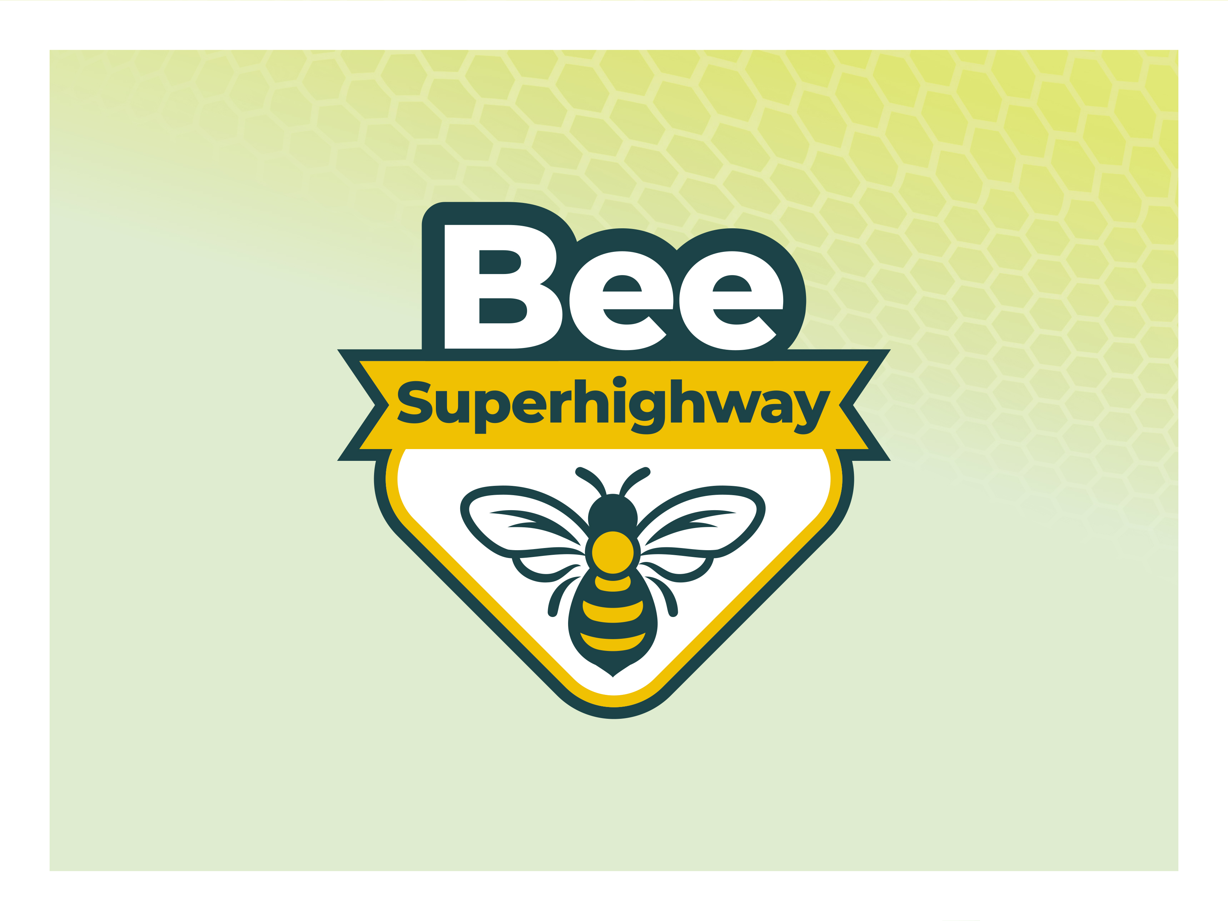
Page 13 of 13 | What is a pollinator?

