Slide 1

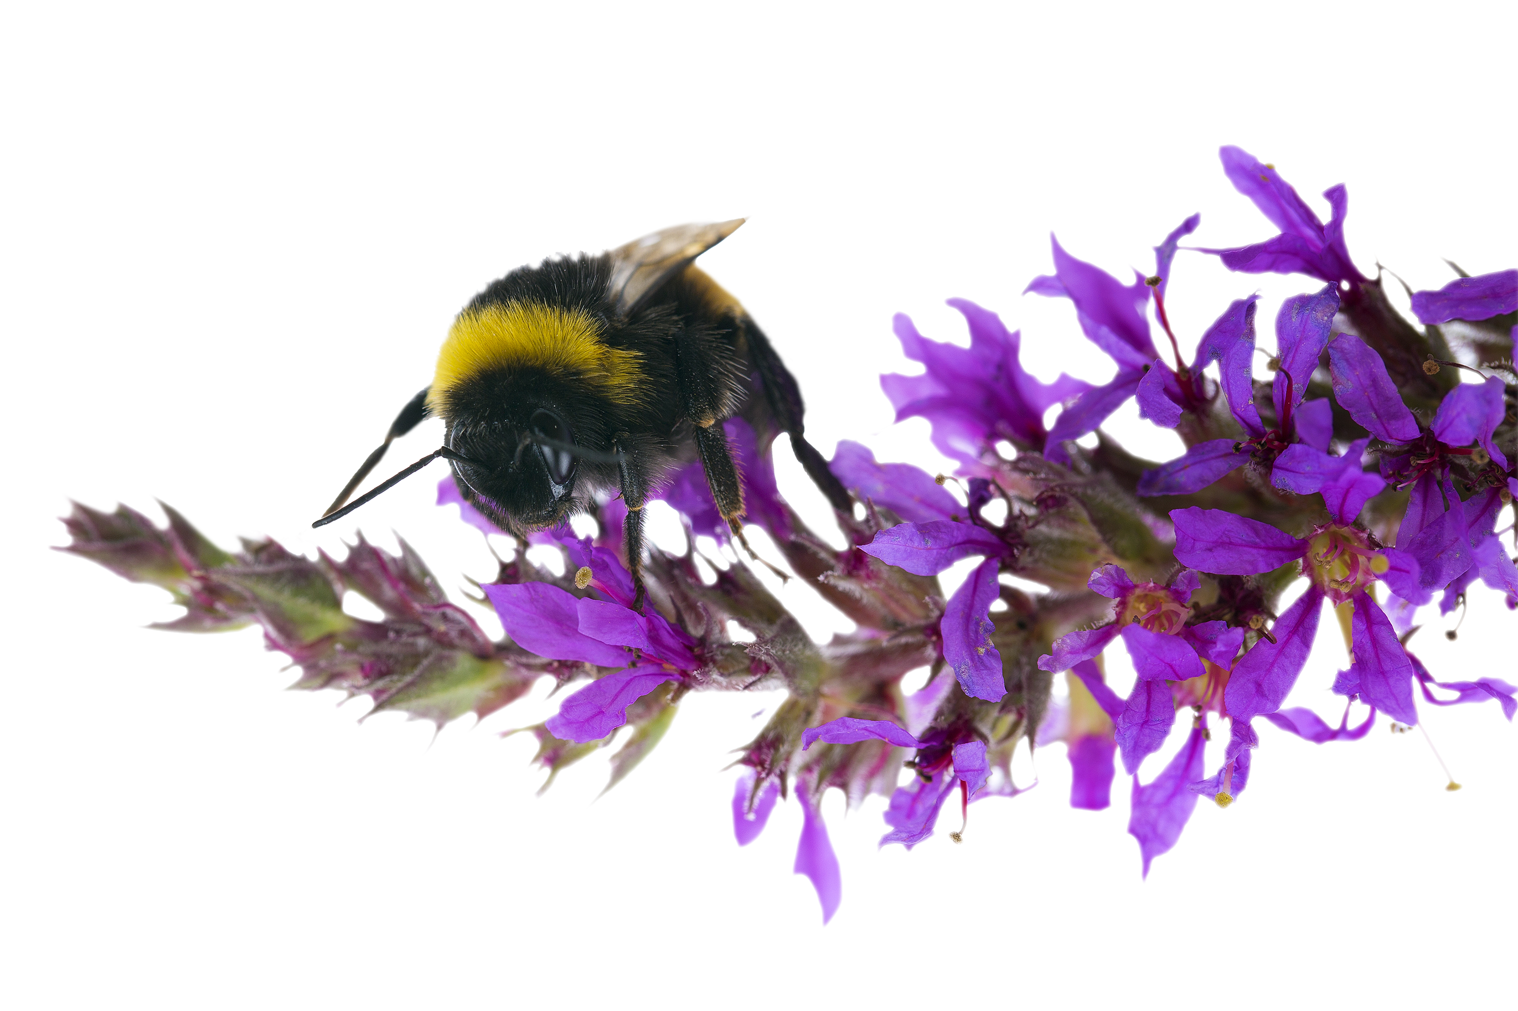
Who pollinates plants?
A session from
the ecology service supporting the
Bee Superhighway
Page 1 of 11 | Who pollinates plants?

Slide 2
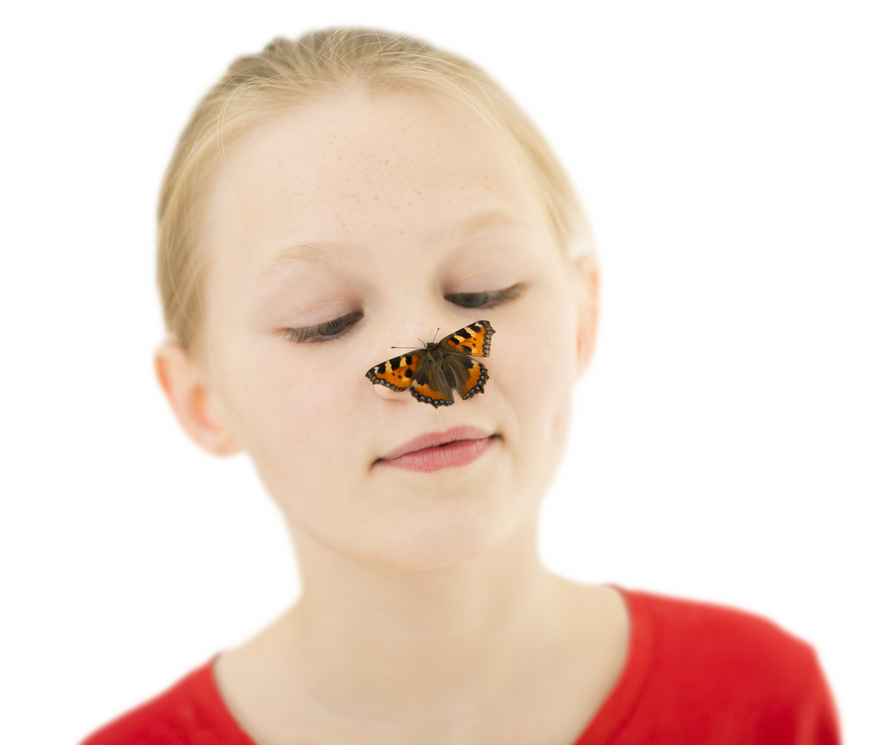
What is a pollinator?
The Bee Superhighway in Kensington and Chelsea is creating more places for pollinators to find food and shelter. But what is a pollinator?
To answer that question,
we must first look at
a flowering plant…
Page 2 of 11 | Who pollinates plants?

Slide 3
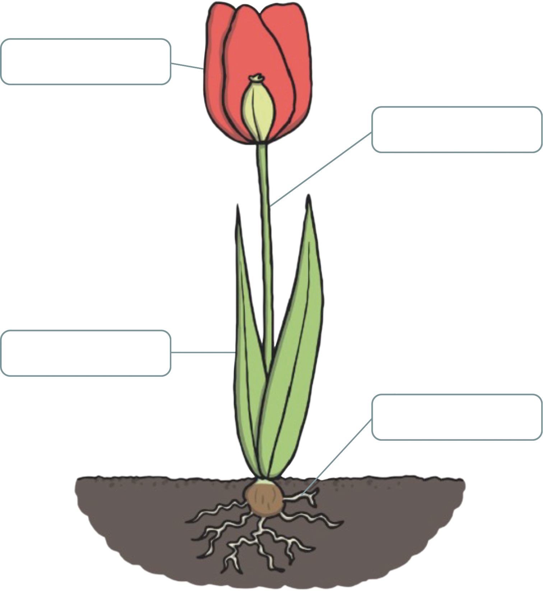

Flowering plant diagram
What are these parts of the plant and what are their functions?
Image courtesy of
Page 3 of 11 | Who pollinates plants?
Notes:
From top to bottom: Flower - involved in plant reproduction and produce seeds; Stem - carries water and nutrients to different parts of the plant; Leaves - use light from the Sun, along with carbon dioxide from the air and water to make food for the plant; Roots – Roots gather water and nutrients. They also hold the plant in the ground.

Slide 4
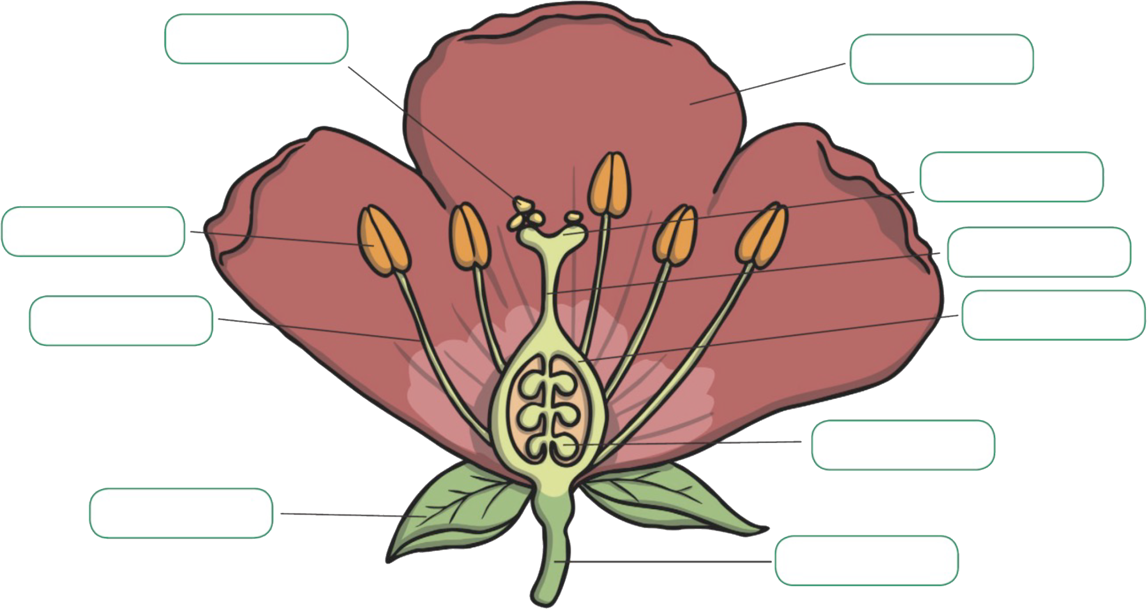
Can you name these parts of the flower?
Image courtesy of
Page 4 of 11 | Who pollinates plants?
Notes:
Clockwise from bottom left: Sepal, Filament, Anther, Pollen, Petal, Stigma, Style, Ovule, Stem

Slide 5
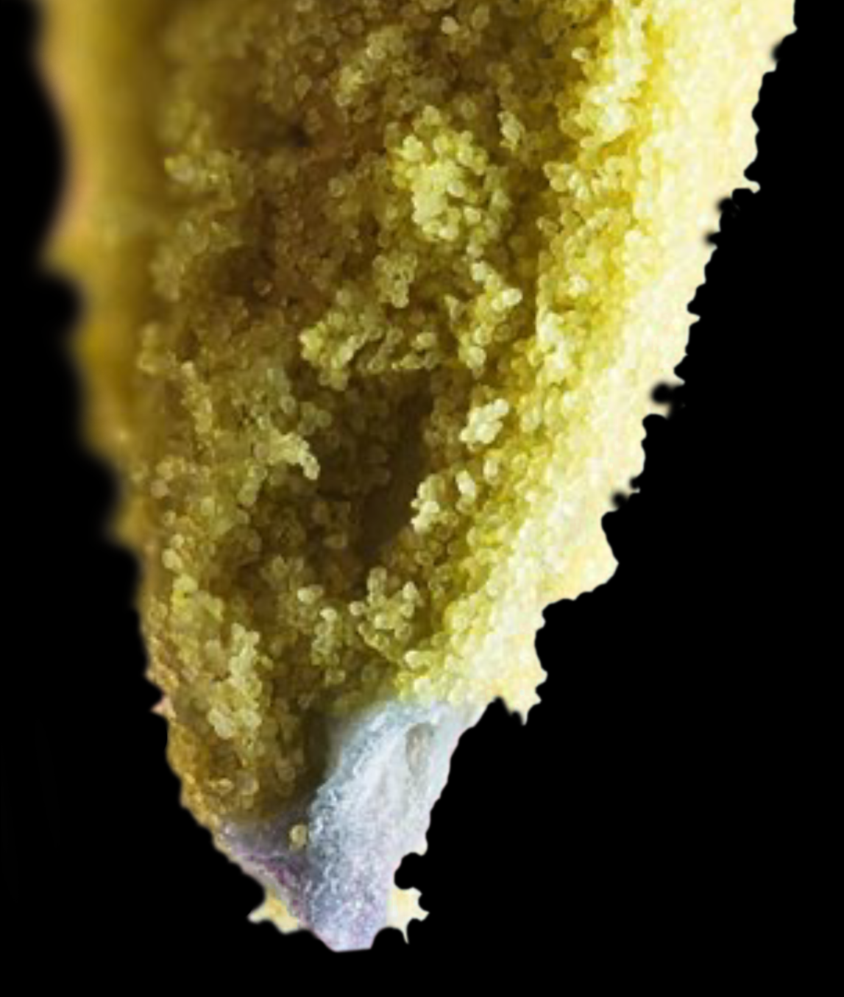
What is pollination?
What do you think this
photo shows?
Pollination is the movement of
the tiny pollen grains from the male
part of a flower (anther) to the
female part of a flower (stigma).
The pollen can then fertilise the
ovule to produce a seed.
Page 5 of 11 | Who pollinates plants?
Notes:
The photo shows a close-up of pollen grains on an anther

Slide 6
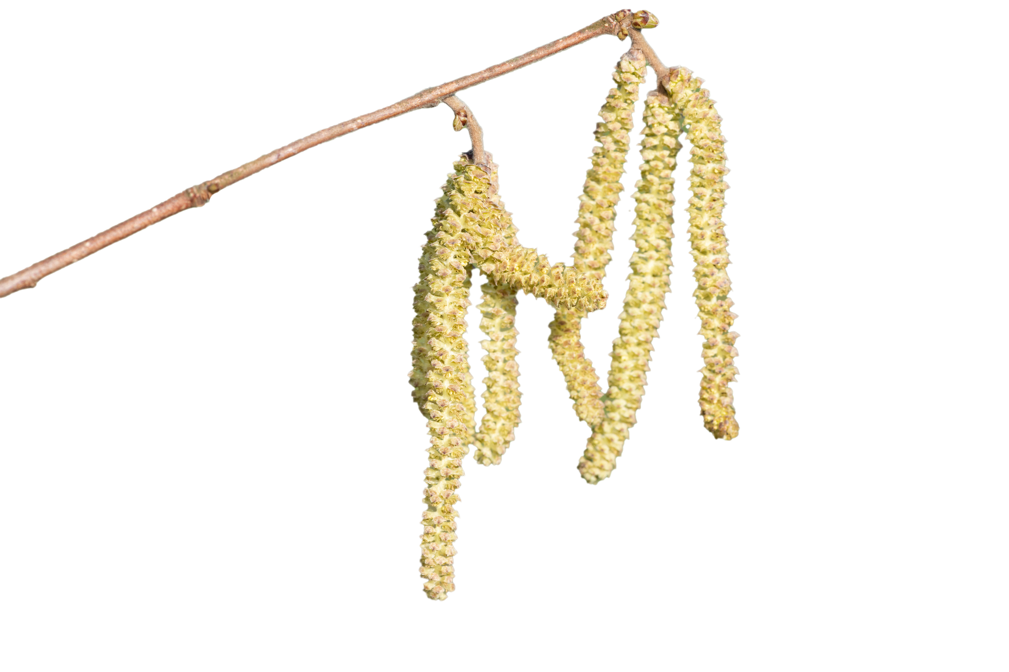
How does the pollen move?
Pollen can be blown by the wind, like with this catkin.
Why do you think the
catkin is this shape?
Page 6 of 11 | Who pollinates plants?
Notes:
Catkins hang down to increase the chance of their pollen blowing on to another catkin

Slide 7
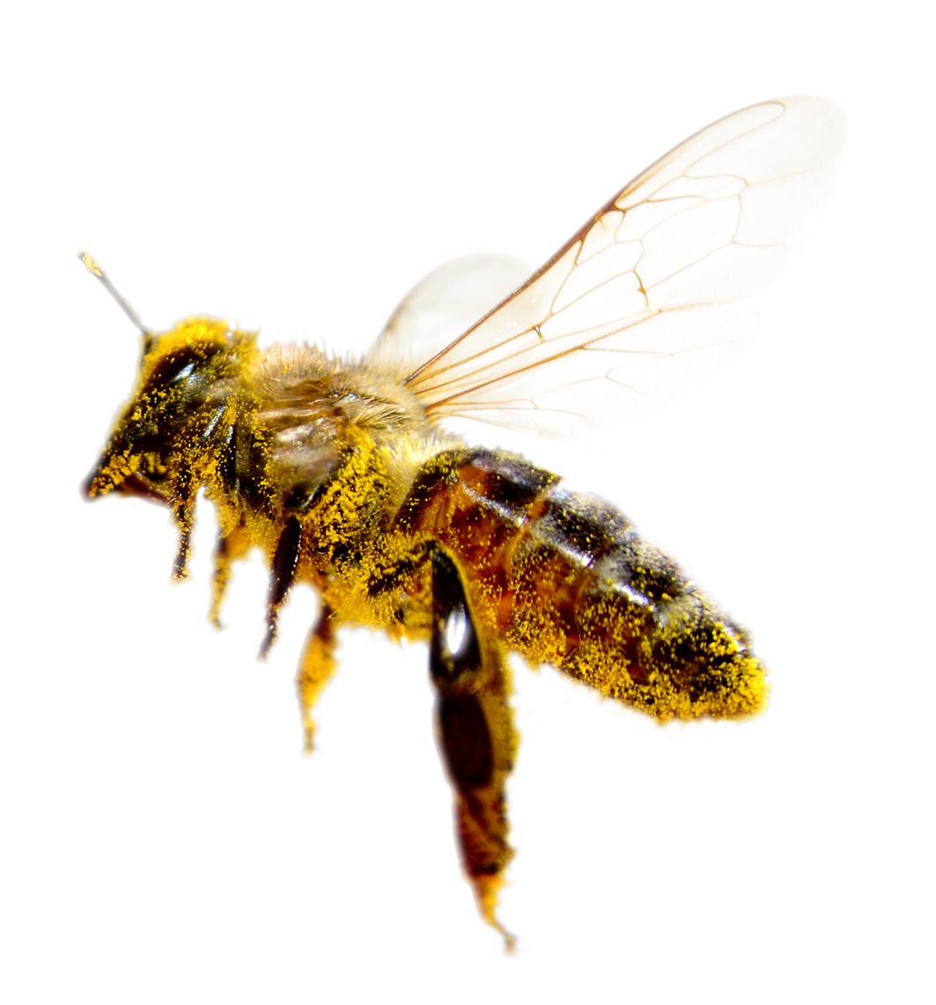
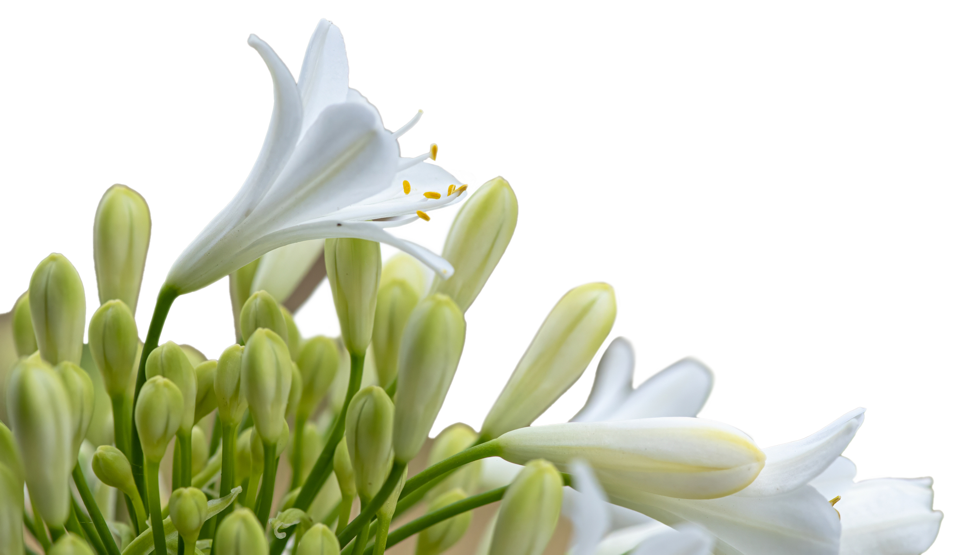
What causes pollen to spread?
Pollen can also be carried by animals. Animals that
help pollinate flowers are called pollinators.
Can you spot the pollen all over the bee’s body?
Why does the bee visit the flower?
Page 7 of 11 | Who pollinates plants?
Notes:
The bee may be attracted to the flower by it’s colour or scent. The bee collects pollen and nectar as food and will accidentally transfer pollen.

Slide 8
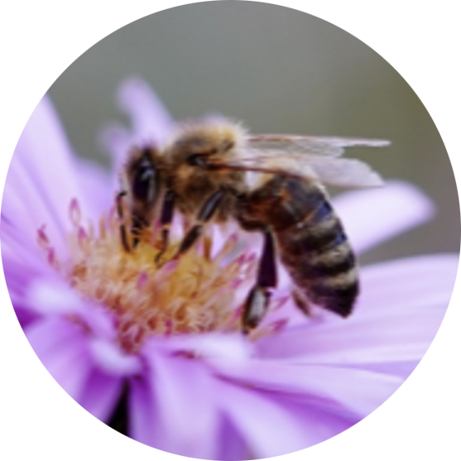
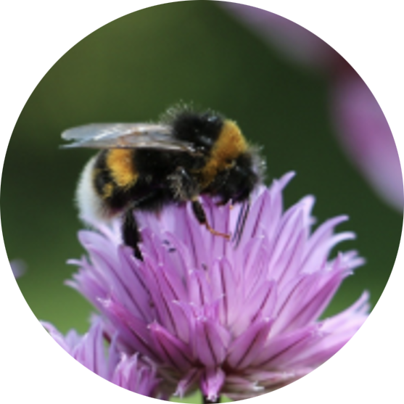
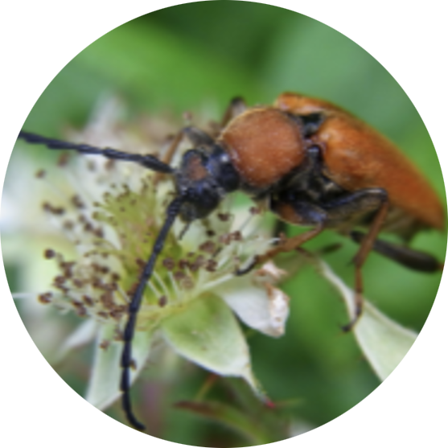
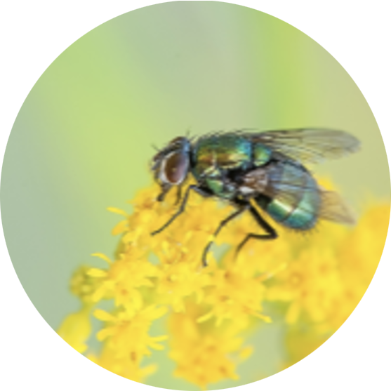
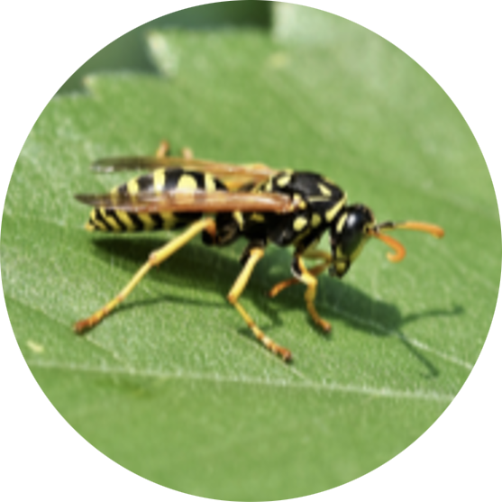
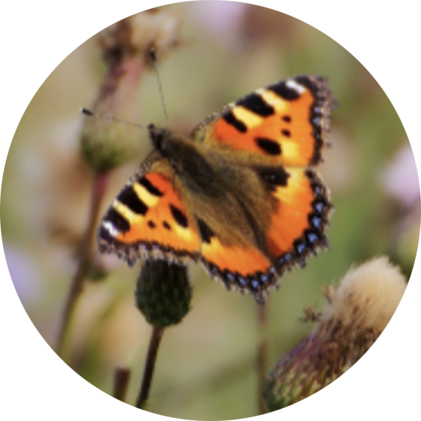
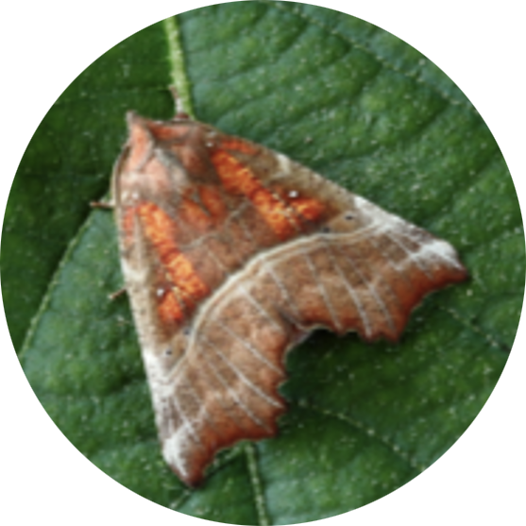
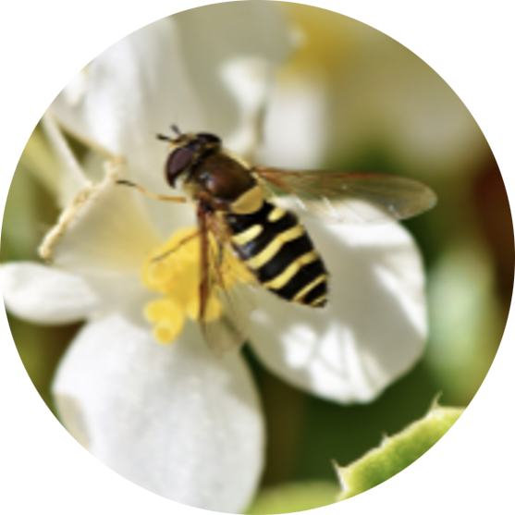
Who pollinates plants?
Most pollinators are insects, such as…
Page 8 of 11 | Who pollinates plants?
Notes:
Top row L-R: Bee, Bumblebee, Beetle, Fly, Wasp.
Bottom row L-R: Butterfly, Moth, Hoverfly

Slide 9
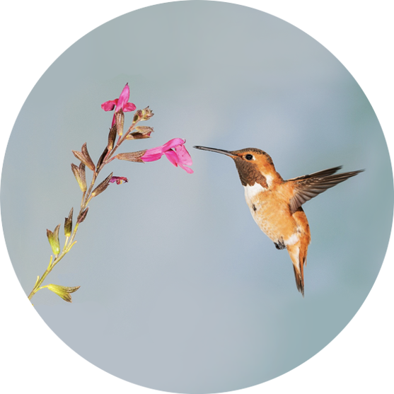
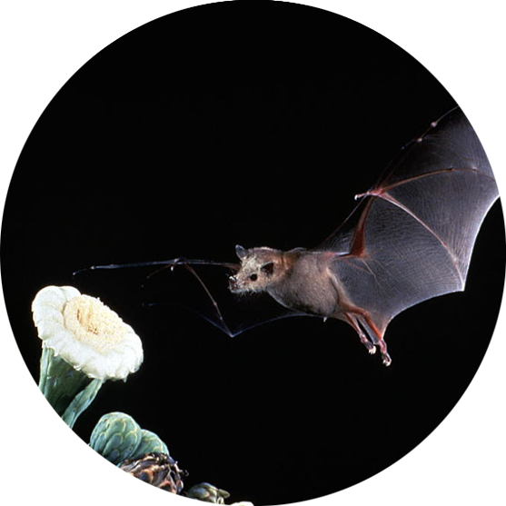
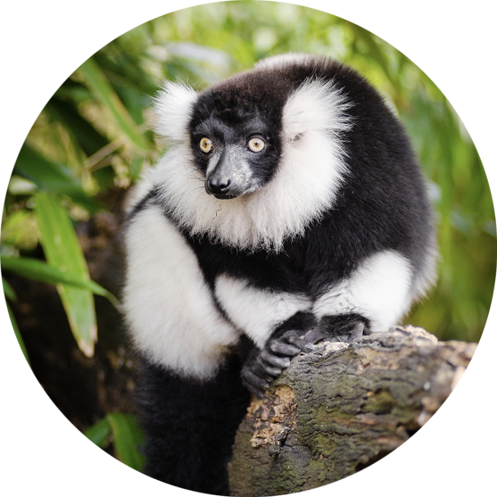
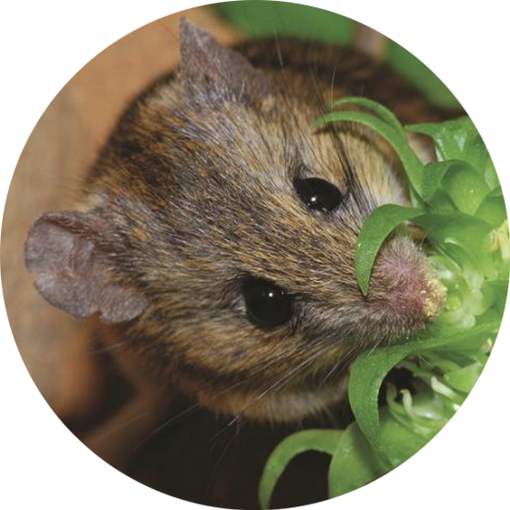
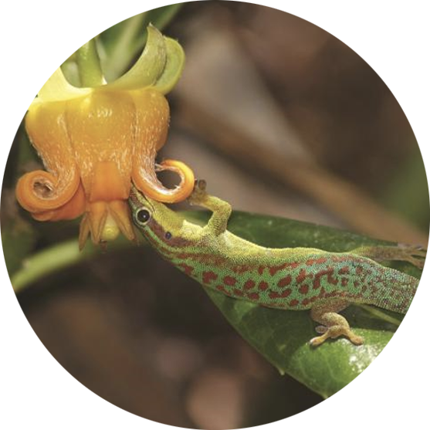
Who else pollinates plants?
In other parts of the world there are more unusual pollinators too!
Page 9 of 11 | Who pollinates plants?
Notes:
Top row L-R: Hummingbird, Bat, Lemur
Bottom L-R: Mouse, Lizard

Slide 10
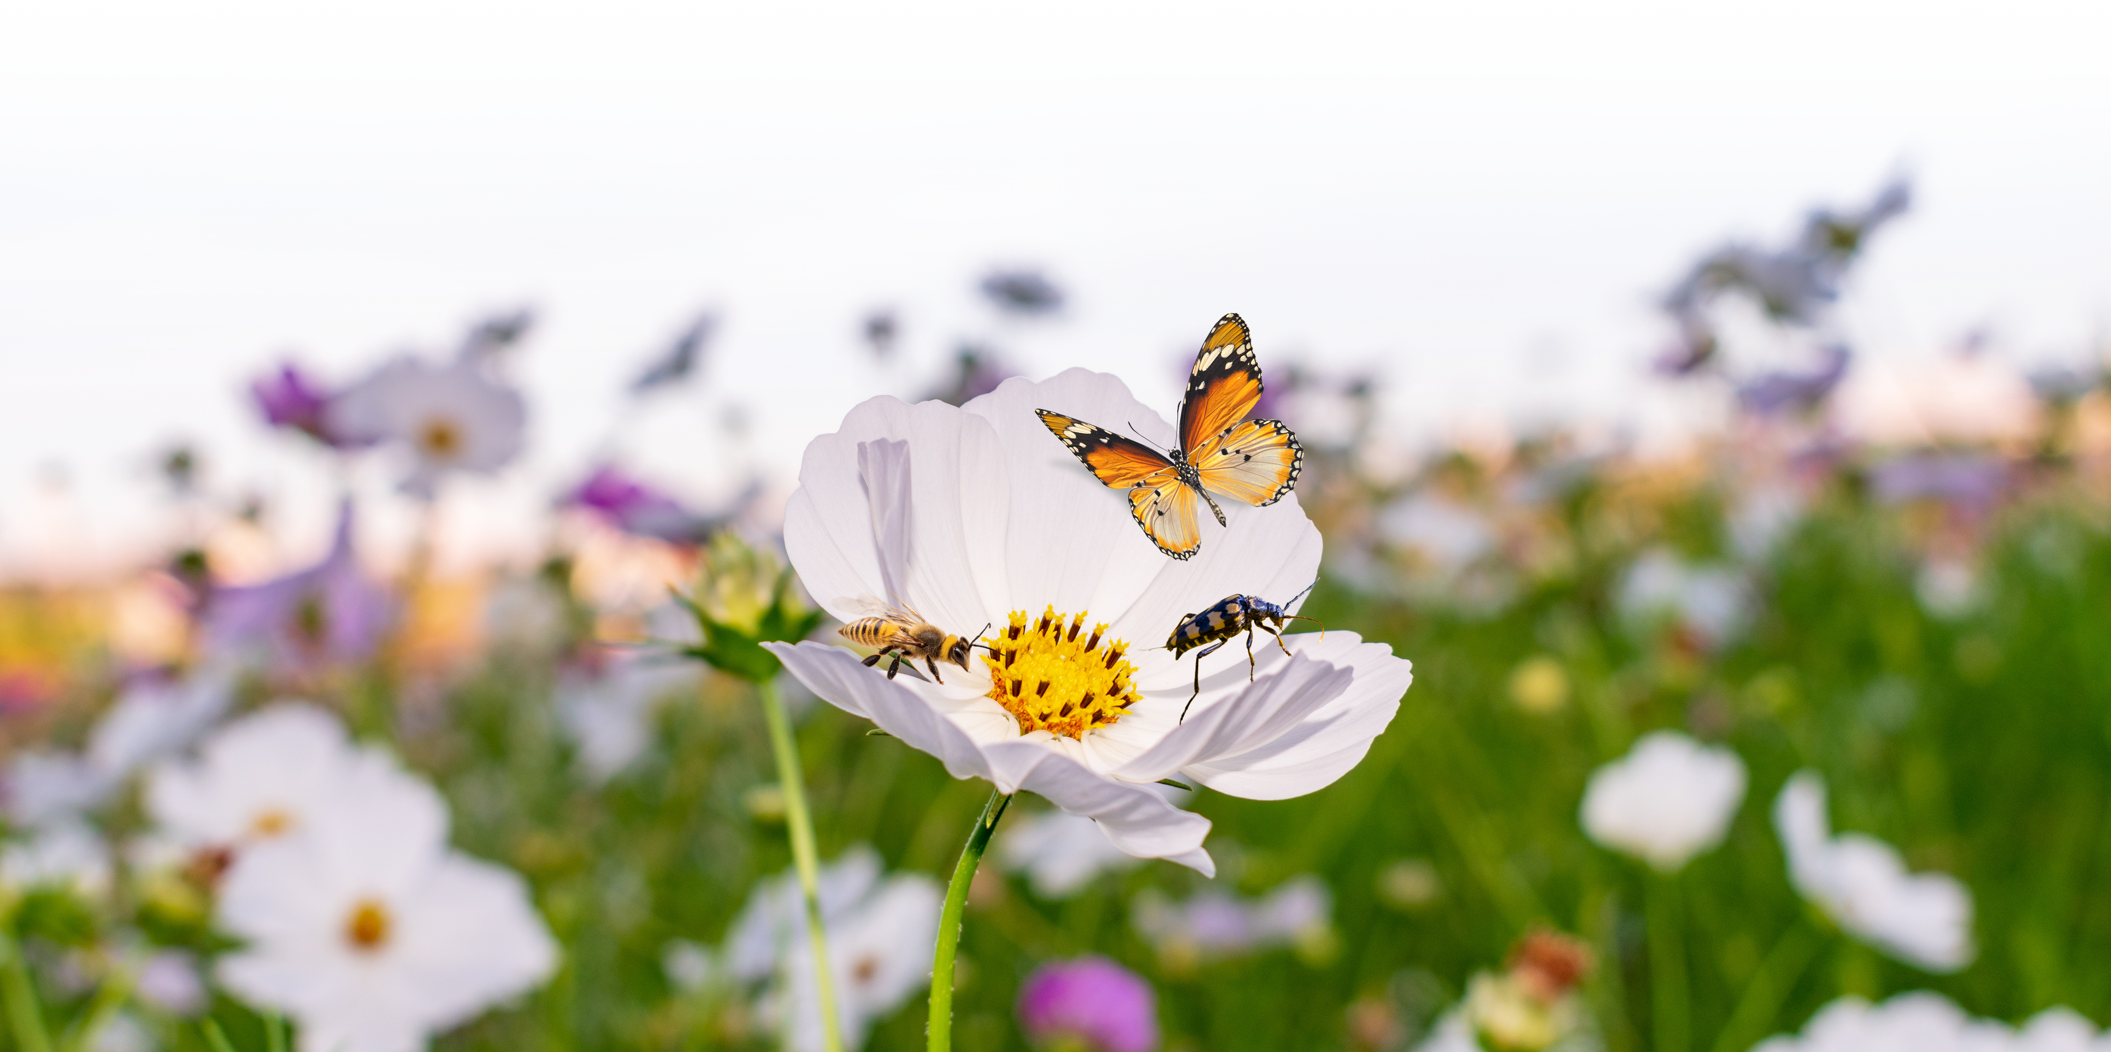

What pollinators can you find outside?
Who do you think will be pollinating
flowers outside today?
Page 10 of 11 | Who pollinates plants?

Slide 11

Page 11 of 11 | Who pollinates plants?

