Slide 1
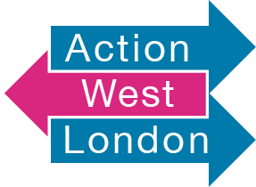
ABLE2 Project

Slide 2
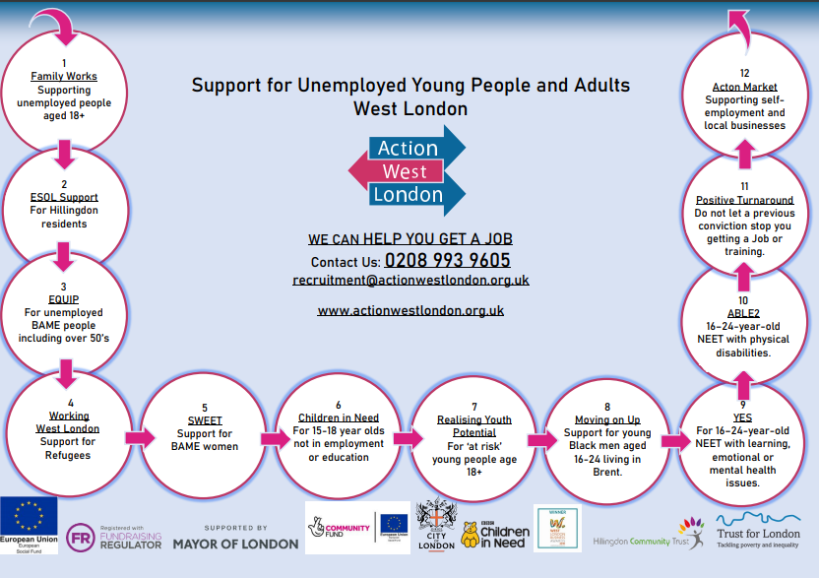

Slide 3
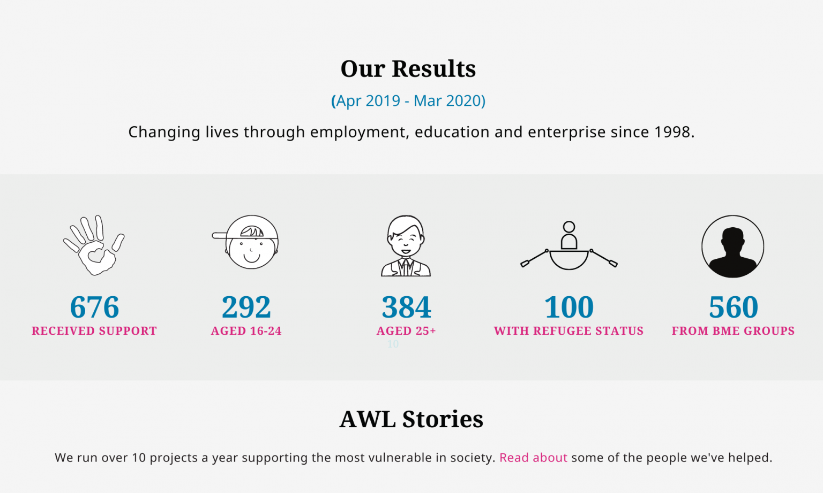

Slide 4
What is the Project?
The ABLE2 project (Ability not Barriers to Learning and Employment2’ ) is to provide specialist, expert support to move young people into a new opportunity be it through education, training, or employment. This project is a free service for young Londoners aged 16-24 that may have physical or long-term health components that could be preventing them from progressing into opportunities.

Slide 5
Eligibility
Meets programme specific eligibility criteria:
Young Londoners aged 16 to 24
Not in Employment, Education or Training (NEET)
Have a physical disability or long-term health condition

Slide 6
Overview
The contracts support NEET young people aged 16-24 with a physical disability or long-term health condition
To Progress learners to start and sustain in:
Employment
Education
Traineeship
Apprenticeship

Slide 7
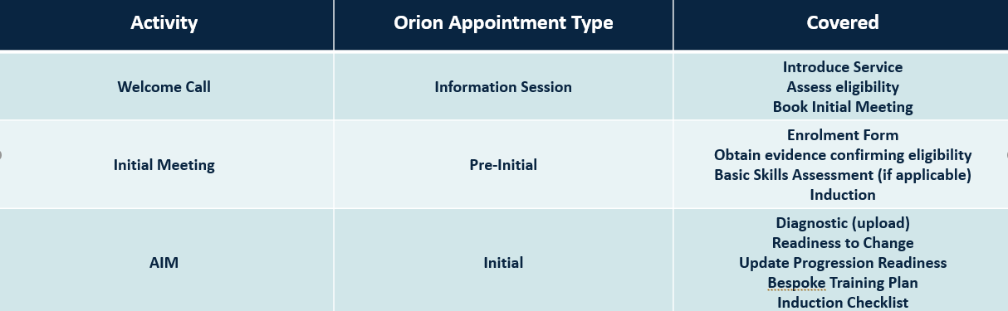
Learners journey

Slide 8
Intervention support
Job taster sessions
CV building
Interview Skills
Resilience
Proactivity
Self awareness
Workplace ethics
Self confidence
Money Management

Slide 9





Progression Support
Online careers center
Job clubs
Functional skills
Internal recruiters
Job brokerage
IWS calls

Slide 10
contact
CLIENTS END THEIR JOURNEY WITH US BETTER EQUIPPED FOR THEIR FUTURE WHETHER THEY ARE IN WORK, OR HAVE OBTAINED SKILLS OR TRAINING
Contact Sowmiya Sivun via:
Email: Sowmiya Sivun@actionwestlondon.org.uk
Contact Number: 07512 388023

