Slide 1
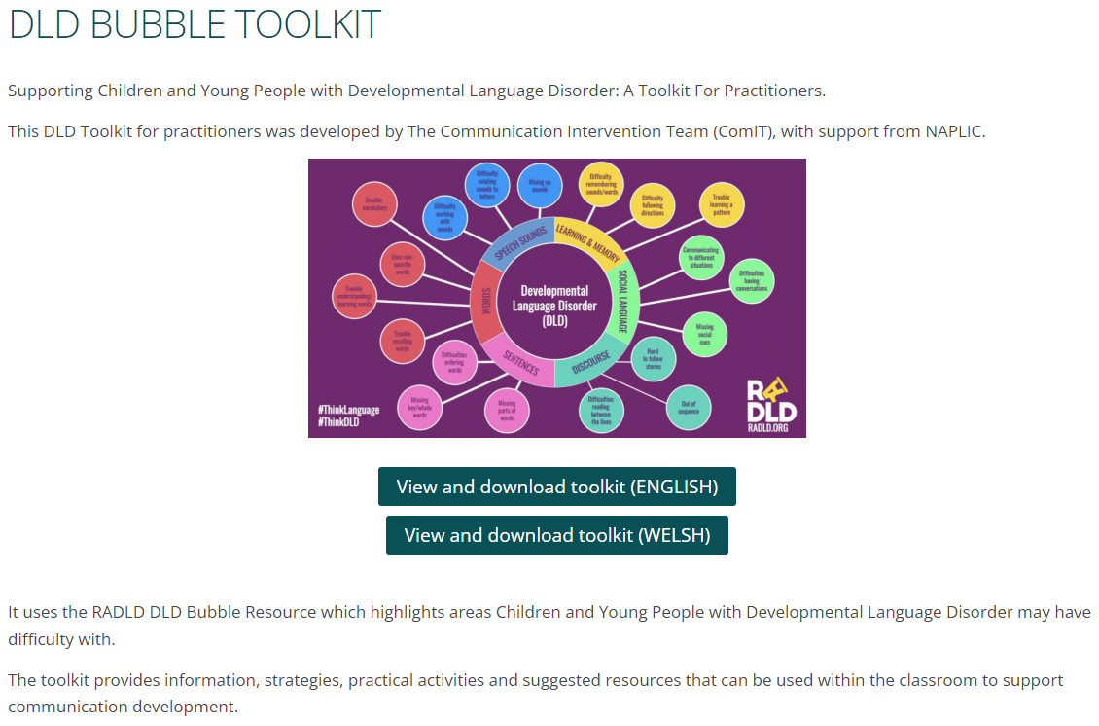

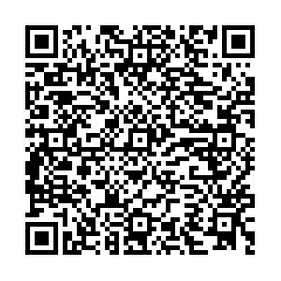
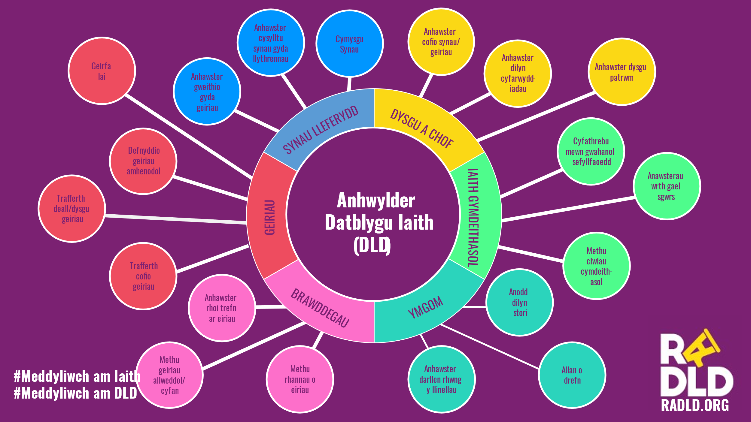
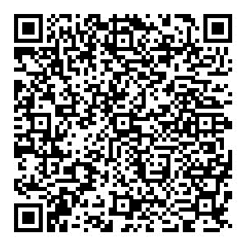
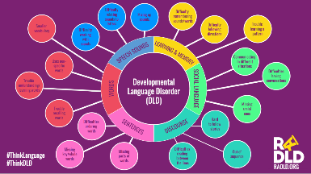
DLD Bubble Toolkit
Toolkit DLD - Pecyn i Ymarferwyr
#DLDbubbleToolkit
NAPLIC | DLD Bubble Toolkit
Notes:
MJS
Based on the RADLD DLD Bubble
Designed to support practitioners working with children who have SLCN - where DLD is suspected or confirmed
Useful advice pre-diagnosis and can support with information needed for a referral to SLT
In this toolkit you will find information on:
What is DLD, the impact of DLD, general strategies to support CYP with SLCN/DLD, more specific information, strategies, activities and resources related to the 6 sub sections of the DLD Bubble
Welsh and English Toolkit available with a recorded introduction, hosted on Naplic
QR code links to the Toolkit (playlist format)

Slide 2

Difficulty relating sounds to letters
Mixing up sounds
Difficulty
remembering
sounds/words
Smaller
vocabulary
Difficulty following directions
Trouble
learning a
pattern
Difficulty working with sounds
Communicating
In different
situations
Uses non-specific words
SOUNDS
LEARNING & MEMORY
Difficulties
having
conversations
Developmental
Language Disorder
(DLD)
Trouble
understanding/
learning words
WORDS
SOCIAL LANGUAGE
Missing
social
cues
Trouble recalling words
Difficulties
ordering
words
Hard
to follow
stories
SENTENCES
DISCOURSE
Missing key/whole words
Missing parts of words
Difficulties
reading
between
the lines
Out of sequence
#ThinkLanguage
#ThinkDLD
RADLD.ORG
Notes:
MJS

Slide 3
Anhawster cysylltu synau gyda llythrennau
Cymysgu Synau
Anhawster
cofio synau/
geiriau
Geirfa
lai
Anhawster dilyn cyfarwydd-iadau
Anhawster dysgu
patrwm
Anhawster gweithio gyda geiriau
Cyfathrebu
mewn gwahanol
sefyllfaoedd
Defnyddio geiriau amhenodol
SYNAU LLEFERYDD
DYSGU A CHOF
Anawsterau
wrth gael
sgwrs
Trafferth
deall/dysgu
geiriau
Anhwylder
Datblygu Iaith
(ADI)
GEIRIAU
IAITH GYMDEITHASOL
Methu ciwiau cymdeith-asol
Trafferth cofio geiriau
Anhawster
rhoi trefn
ar eiriau
Anodd
dilyn
stori
BRAWDDEGAU
YMGOM
Methu geiriau allweddol/ cyfan
Methu rhannau o eiriau
Anhawster
darllen rhwng
y llinellau
Allan o drefn
#Meddyliwch am Iaith
#Meddyliwch am ADI
RADLD.ORG
Notes:
MJS

Slide 4
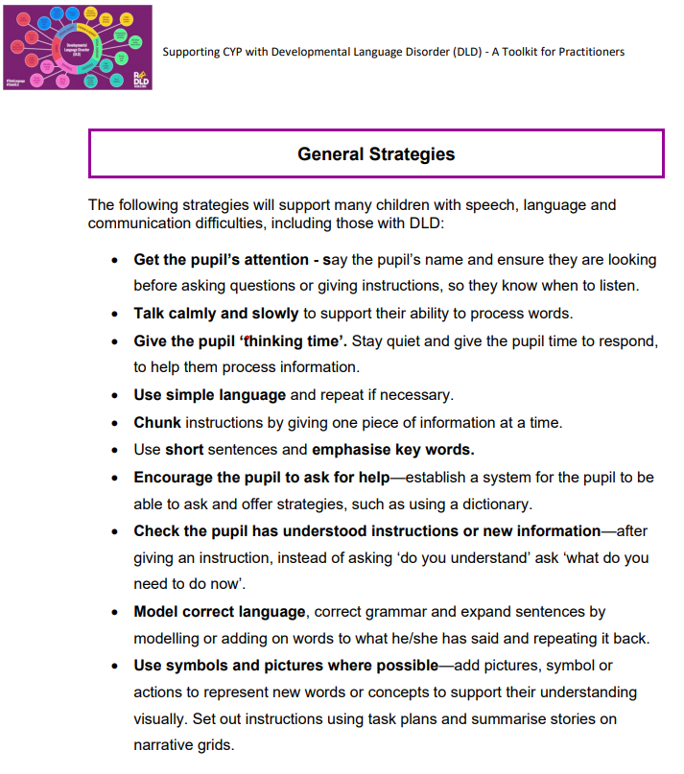
Can be found and downloaded from the DLD Bubble Toolkit
SOUNDS
LEARNING & MEMORY
WORDS
SOCIAL LANGUAGE
SENTENCES
DISCOURSE
Notes:
MJS

Slide 5

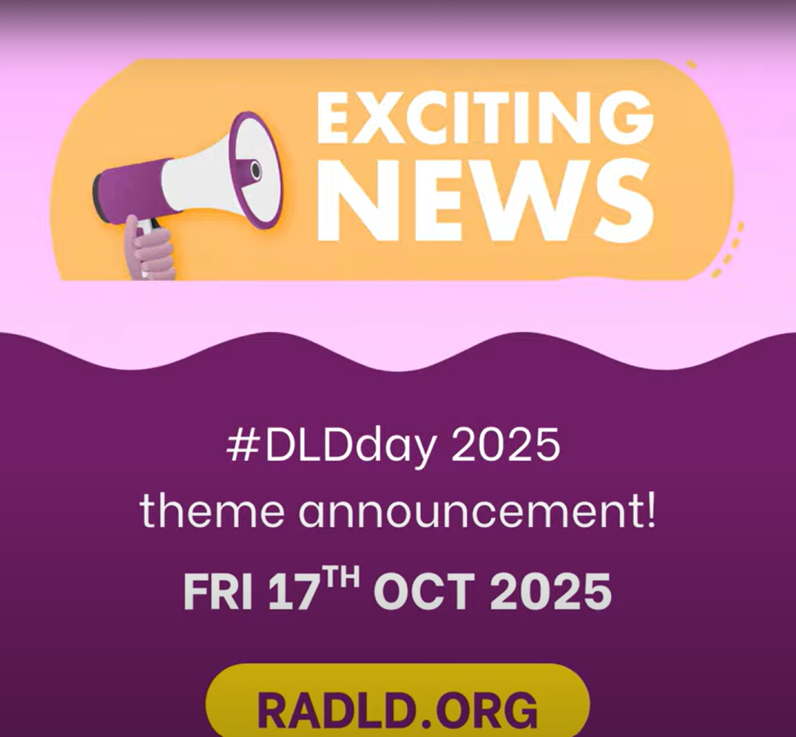

RADLD DLD DAY 2025 LAUNCH VIDEO
RADLD - Raising Awareness of Developmental Language Disorder
Notes:
MJS
Watch the Launch Video to find out the theme for DLD Day 2025!
Would you like to host a DLD Information Station in your school for staff / parents?
Could you invite others to join you in school?
Have you got a cluster event planned in Oct/Nov 2025?
Contact ComIT for more information & to book in early by emailing sencom@torfaen.gov.uk

