Slide 1
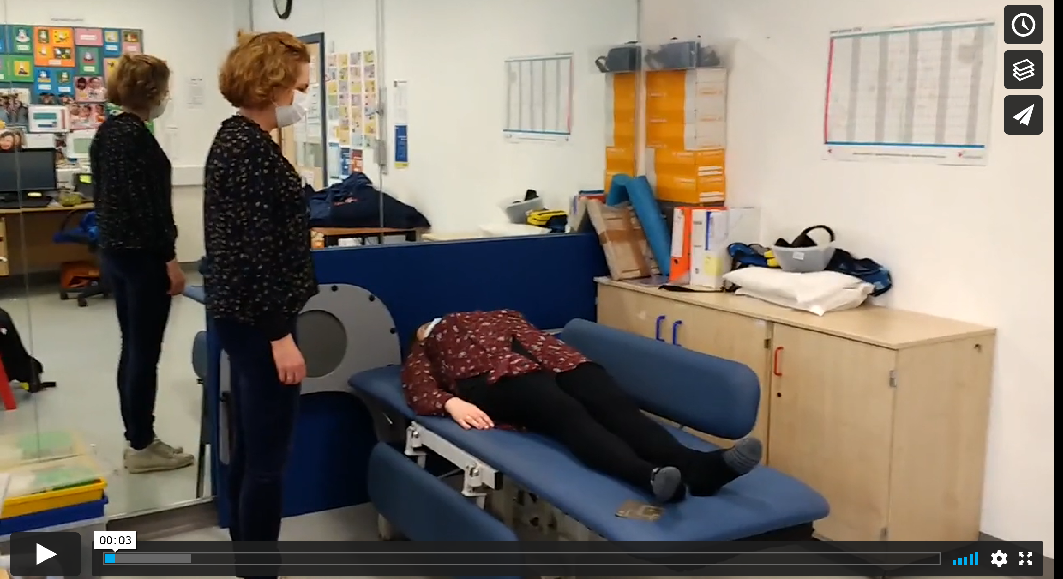
Videos of how and why to use a hoist and sling to help someone from a bed to a chair
Introduction to using a hoist
click on link below to play video
https://vimeo.com/519558662

Slide 2
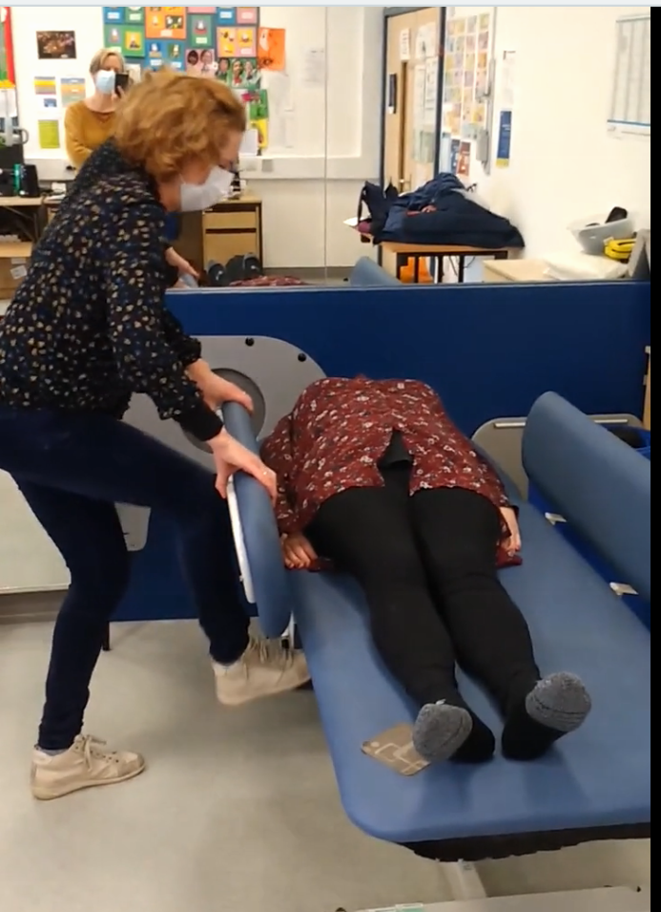
Adjusting height of bed if hoisting from bed
Click on link below to play video
https://vimeo.com/519563899

Slide 3
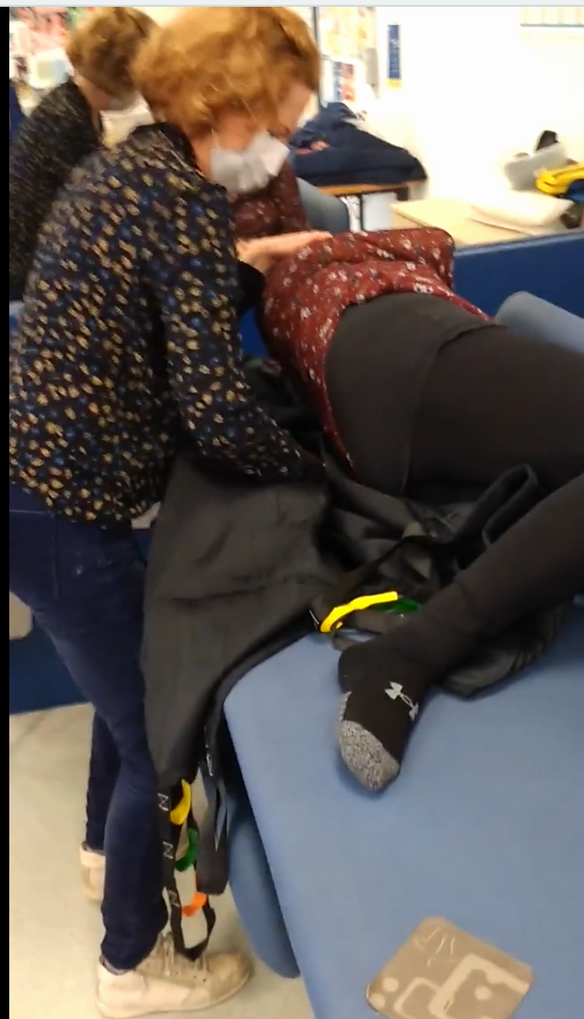
Using a hoist to lift someone who cant move from a bed
Click on link below to play video
https://vimeo.com/519565268

Slide 4

Hoisting someone from a chair to a bed
https://vimeo.com/519569363
Click on link above to play video

Slide 5

Keeping your hoist charged and other final points
https://vimeo.com/519571045
Click on link above to play video

