Slide 1

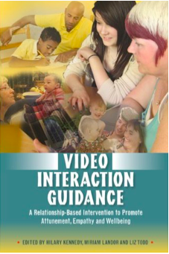
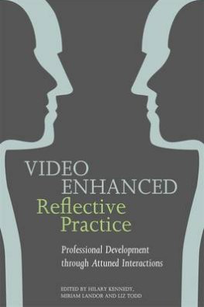
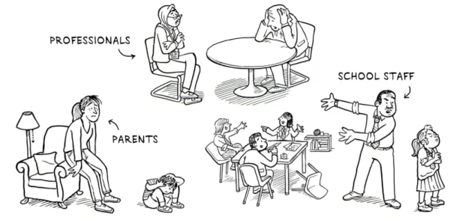
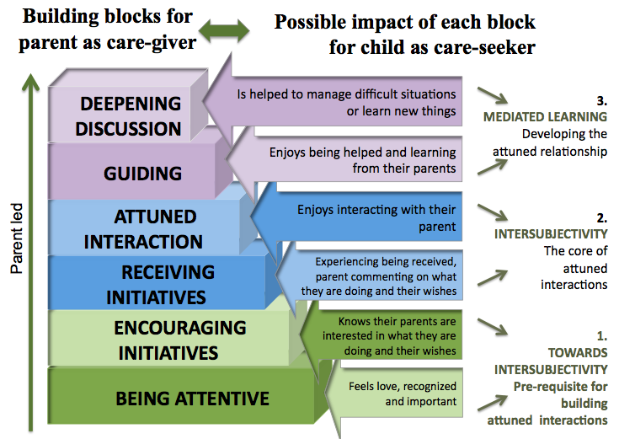
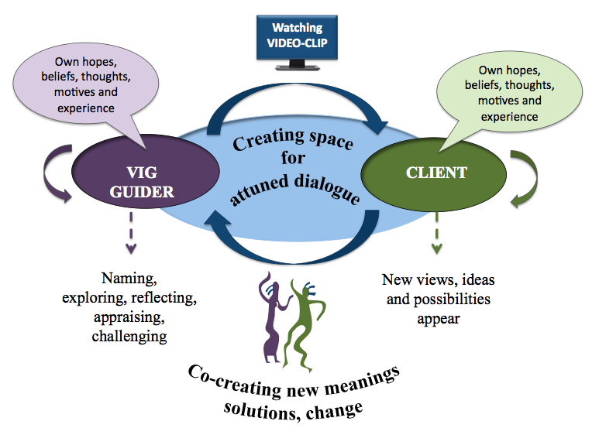
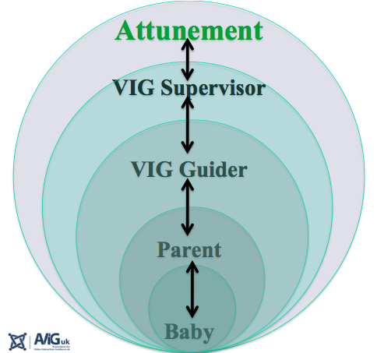
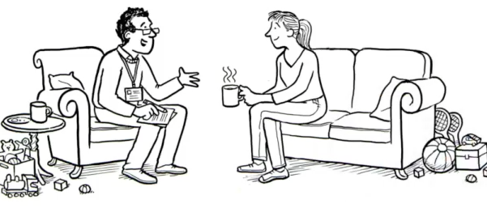
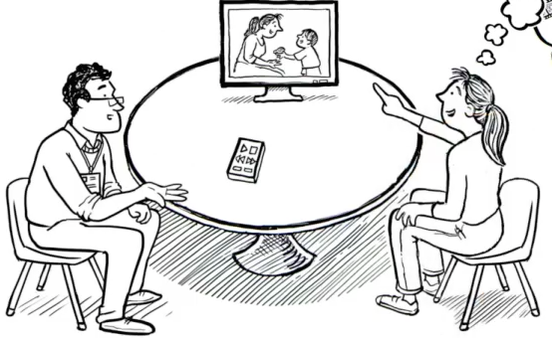
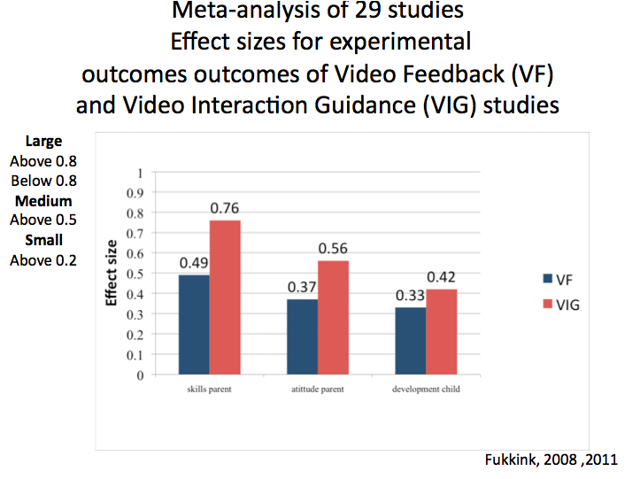
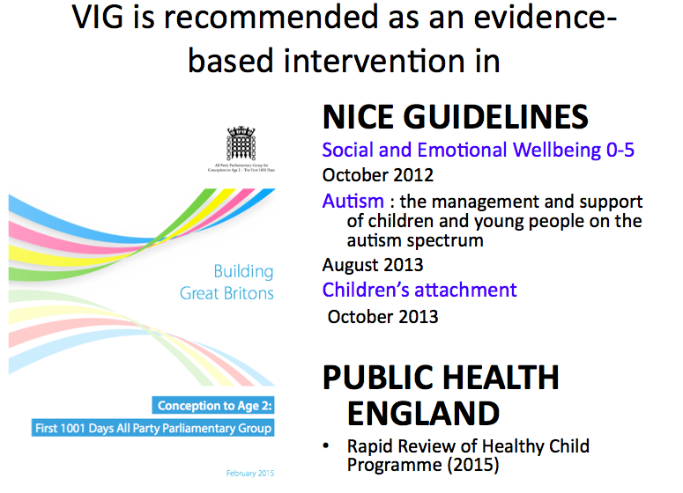
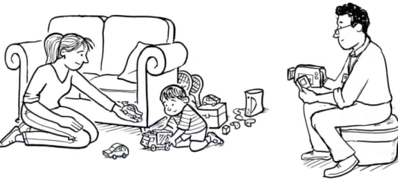
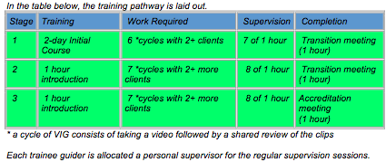
Video Interaction Guidance
www.videointeractionguidance.net
Video Interaction GuidanceTM is an intervention through which a practitioner uses video clips of authentic situations to enhance communication within relationships.
It works by engaging clients actively in a process of change towards realizing their own hopes for a better future in their relationships with others who are important to them.
Who can benefit from VIG?
Selection of clips
Theoretical base
The guider micro-analyses the video using the framework below
3 short clips of moments where the parent attunes to the child
and relate to the parent’s “Helping question” are selected
Intersubjectivity (Trevarthen 2001, Braten 2009, Stern 2010)
Mediated learning (Vygotsky 1967, Bruner 1996)
Sensitivity/attunement (van Ijzendoorn 1995)
Mid-range contingency (Beebe & Steele 2013)
Mentalisation (Reflective Function and Marked Mirroring (Fonagy et al 2002)
Mind-mindedness ( Meins et al 2013)
Parental Embodied Mentalization (Shai & Belsky,2011)
INTERSUBJECTIVITY underpins the QUALITY OF ALL RELATIONSHIPS IN VIG
Principles of attuned interaction and guidance
Anyone who would like improve their relationships
Engagement in change
The values of Trust, Hope, Respect
Compassion, Co-operation and Appreciation
underpin every conversation
,
The shared review
Research evidence
The Helping Question : starting from what the clients want
towards working out how they can make the changes they want
The Guider supports the parent to see what she is doing that
helps to build an attuned relationship with her child
and moves towards her own goal .
These review sessions last between 30 mins and one hour
3-4 cycles( video and shared review) usually produce
significant change. Number of sessions is flexible
Taking the video
Training in VIG
AVIGuk accredited training is available to anyone in the helping professions
There is an Initial 2 day training Course followed by 3 stages of supervision
Selected recent RCTs
Crying babies and parents in residential treatment (Klein Velderman et al. 2013)
Premature babies and their parents (Barlow et al in press, Hoffenkamp et al 2015)
Families with children under 2 (Høivik et al 2015)
Adoptive parents (Colonnesi et al. (2013)
Children at risk of maltreatment (1-5years) ( Moss et al. 2011)
The VIG Practitioner takes 5-10 minutes of better than usual
interaction. He is part of the process and can prompt or encourage
The filming often takes place in the home but can be anywhere
Discussed between parent and guider

